Slide 1
SAP
ECC Basic Navigation

Slide 2

Welcome
This course consists of discussions about new concepts and processes, demonstrations, exercises, and quick reference materials. During the course, we will…
Prepare you for what is new or changing
Tell you what you will be able to do
Show you how to complete transactions in SAP
Let you practice in a structured environment and learn from your mistakes
Help you use quick reference materials

Slide 3

Course Components
Participant Guide
  Concepts
  Check Your Understandings
Activity Guide
  Work Instructions
  Exercises/Demonstrations
Job Aids
Course Evaluation
Notes:
The screens utilized in this training have been captured from the Development SAP Environment. Because the system may not have been completely customized to the final version as the time this course was written, the views on your monitor may appear slightly different than the views depicted in this course. The differences, however, do not and will not affect the manner in which you work within the SAP Environment.

Slide 4







Ground Rules
 | Sign the attendance sheet |  | Help manage activities by starting and stopping on time
 | Silence cell phones and pagers |  | Actively listen and participate in presentations; minimize side conversations
 | Do not work on computers during instructor presentations |  | Check E-mail during breaks ONLY
 | Feel free to ask questions |  | Provide feedback to improve training

Slide 5

Course Modules
This course is intended to introduce you to SAP ECC Navigation. In this course participants will learn about navigating the SAP ECC system, practice using its features, learn about generating reports and the related SAP terminology.
The course is composed of the following modules:
Module 1: Overview of SAP and Loudoun Water Financial Structures
Module 2: The SAP Screen
Module 3: Navigating in SAP ECC
Module 4: The SAP Business Workplace
Module 5: Report Features and Tools
Module 6: Summary
Notes:
SAP is software that integrates and streamlines business processes that span various applications and data sources. Using SAP, you can access and display the data and transactions you will use to complete your tasks. This course will cover the basics of SAP Navigation, including an overview of the SAP software, how to log on to and off of SAP, understanding the various window screens and toolbars, how to move around in SAP, how to create favorites and user preferences. We will demonstrate how to use selection criteria to generate reports specific to your area of concern and finally how to seek help on SAP should you experience problems while using the software.

Slide 6
Course Objectives
Upon completion of this course, you should be able to:
Explain the Loudoun Water financial structure and how it is supported in SAP
Access SAP ECC through the GUI and navigate within SAP
Describe various types of reports available in SAP
Access reports using a menu path or transaction code
Use the features of SAP to generate reports and customize for personal use
Access Help functions for SAP

Slide 7
Overview of SAP and Loudoun Water Financial Structures
Module 1

Slide 8

Module Objectives
Upon completion of this module, you should be able to:
Describe the organizational module and financial structure of Loudoun Water
Describe what SAP modules, applications and transactions are
Describe the Organizational view in SAP
Explain the difference between Finance and Controlling reporting
Explain how SAP manages data
Describe the types of data used in SAP

Slide 9
Overview of SAP
SAP consists of application modules that support of all of Loudoun Water’s transactions and integrates those interactively.
SAP
Finance
Project Systems
EAM
Human Resources
Payroll
Utility Billing
Because it is modular, companies are able to implement the components of SAP that best fit their needs.
It also allows companies to easily grow in their use of SAP
Notes:
SAP is an application that integrates a company’s core business functions in a seamless and efficient manner.
SAP is designed to handle data and information related to an entire corporation.
SAP consists of business areas (modules) that are integrated, meaning that data entered in one functional module is available to other functional modules.
With SAP, it is easy to manage just about any aspect of any business, regardless of size or complexity.
Unifies Loudoun Water's operations into one common and standardized system.
Provides timely, accurate information providing relevant analysis and intelligence needed for our business leaders and employees to make informed decisions.

Slide 10
Modules, Applications, and Transactions
SAP data is structured by modules that correspond to business areas.
Business functions within a module are organized into applications. Business steps or activities within the applications are organized into transactions.
Module
(Business area)
Application
(Business function)
Transaction
(Business activity)
Financial Accounting
General Ledger
Accounts Receivable
Accounts Payable
Create Cost Center
Create Cost Element
Edit Commitment Item
Notes:
Modules are groups of transactions that fit a specific component in SAP. For example, the Human Resources module has transactions for entering time, approving time, maintaining employee data, tracking employee training, benefits, hiring, and termination. The Materials Management module has transactions for purchasing and receiving goods and inventory management, while the Plant Maintenance module manages work orders and plant maintenance.
Because SAP is integrated, a change in one application module results in an automatic update of the data in the other modules involved.

Slide 11
Accessing SAP
Users will be able to access SAP through various channels based on job function, associated security, and task.
SAP
IC Web
ESS
SRM
ECC
IC Web – Web-enabled access for customer service representatives
ECC – Enterprise Central Component
ESS – Employee Self-Service
SRM – Supplier Relationship Management
Notes:
ECC is the basic set of integrated applications and components that comprise core SAP ERP. SAP ECC is made up individual, integrated software modules that perform various organizational system tasks.
ESS is where you will enter timesheets and maintain personal data such as contact information, bank details, and leave requests.
SRM is used for building shopping carts and starting the Procurement process.
IC Web is used in Customer Relations.
SAP ECC is a database of information for an organization. Information may be entered into the database from any point and then viewed across the organization as needed.
A Client is a self-contain unit within the ECC system with separate records and data. The client you will be working in is dependent on the role or task to be performed. For example, during a training session, you will most likely be working within a Training client so as not to contaminate the data in the Production client. The Production client is the live-working environment, the data of which needs to remain pristine.
During each use you can only access the data of the client selected during the logon.

Slide 12
Overview of Loudoun Water Finance Structure
Company
LW0000
Company
The Company is used to consolidate Company Code information for consolidated financial reporting.
Company is represented by a 6 digit alpha-numeric field.
Company = LW0000

Slide 13
Overview of Loudoun Water Finance Structure
Company
LW0000
Controlling Area
Controlling Area is an organizational hierarchy element to which Cost Centers, Profit Centers and Cost Elements are assigned to.
All cost accounting components are self-contained within the Controlling Module.
The Controlling Area also houses other cost objects such as Work Breakdown Structure (WBS) elements.
The Controlling Area is a required element to enable cost management.
Controlling Area is represented by a 4 digit alpha-numeric field.
Controlling Area = LW00
Controlling Area
LW00

Slide 14
Overview of Loudoun Water Finance Structure
Company
LW0000
Chart of Accounts
Chart of Accounts is the organizational unit (holder) which contains all General Ledger accounts used by the Company Code.
Chart of Accounts contains the proprietary GL Accounts.
The Chart of Accounts Organizational Unit name is a 4 digit alpha-numeric field.
Chart of Accounts = LW00
Controlling Area
LW00
Chart of Accounts LW00

Slide 15
Overview of Loudoun Water Finance Structure
General Ledger Accounts
Cash
General Ledger (GL) accounts are the structures that classify debit and credit values for accounting transactions and form the basis for creating financial statements
GL accounts represent types of financial postings such as Assets, Liabilities, Revenues, and Expenses and are created at the lowest possible level to capture financial information, both for internal and external reporting, analysis and reconciliation.
The GL Account field is a 10-position numeric field and are based on the existing Loudoun Water 6 digit GL accounts and account groupings.
accounts
Cash
Company code specific
000000
settings
-
C
099999
100000
-
199999
Asset
Account definition
200000
in chart of
-
299999
General ledger
accounts
Material
300000
-
399999
P/L
Account 001111
400000
-
499999
Cash
Account
000000
-
Liab
099999
500000
.
Account
groups
group
-
599999
...
600000
-
699999
Notes:
In order to organize and manage a large number of G/L accounts better, they are arranged in account groups.
The accounts of an account group normally have similar business functions. You could, for example, have an account group for cash accounts, one for expense accounts, one for revenue accounts, and one for other balance sheet accounts, etc.

Slide 16
Overview of Loudoun Water Finance Structure
Company
LW0000
Company Code
The Company Code is an organizational unit where financial statements are generated.
It is the organizational unit for which a complete self-balancing set of accounts can be maintained for purposes of external legal reporting.
A company code can, for example, be a company or subsidiary.
Company Code is represented by a 4 digit alpha-numeric field.
Company Code = LW00
Controlling Area
LW00
Chart of Accounts LW00
Company Code
LW00

Slide 17
Overview of Loudoun Water Finance Structure
Company
LW0000
Profit Center
A profit center is a management oriented organizational unit used for internal controlling purposes.
Dividing the company up into profit centers allows one to analyze areas of responsibility and to delegate responsibility to decentralized units, thus treating them as “companies within the company”.
Controlling Area
LW00
Chart of Accounts LW00
Company Code
LW00
Profit Center
Notes:
Profit Center Definition
Profit center has internal areas of responsibilities.
Each profit center has responsibility for revenues, expenses, and in some cases certain assets and liabilities.
Profit centers create profits individually and separately from other profit centers.
Every profit center is assigned to the organizational unit controlling area.
The following Profit Centers have been identified at LW:
Water
Wastewater
Reuse
Each individual Community Systems for example Lenah Run, Raspberry Falls etc.

Slide 18
Overview of Loudoun Water Finance Structure
Company
LW0000
Cost Center
The Cost Center Structure is used to represent the organization levels at which each Department tracks spending or collects costs.
It is the lowest level at which costs can be allocated in an organization.
Controlling Area
LW00
Chart of Accounts LW00
Company Code
LW00
Profit Center
Cost Center
Cost Center
Notes:
Description
Organizational unit within a controlling area that represents a defined location of cost incurrence. The definition can be based on:
Functional requirements
Allocation criteria
Physical location
Responsibility for costs
Defines the smallest area of responsibility within the company that causes and influences costs; the lowest level to which you can meaningfully assign direct and indirect costs
Cost Center Category is used in functional area reporting as well as restricting the activities that can be performed by a cost center. LW will use the following Cost Center Categories:
1 – GM Office
2 – Operations
3 – Finance
4 – Administration
5 – Non Departmental

Slide 19
Financial Reporting
The Controlling module addresses the internal accounting requirements of the organization.
Characteristics | Financial Accounting | Controlling
Type of Information | Financial Information | Cost and Profitability
Usage | External Usage | Internal Usage
Scope | Legal Entity as a total | Different internal areas of responsibility
Interest Groups | Main interest group: CFO, financial institutions, auditors, tax authorities | Main interest group: Management
Provided Tools | Provides tools for financial reports (P&L, Balance Sheet), Account Analysis | Provides tools for Budgeting/Planning, Reports for Plan Actual Comparisons
Notes:
The Controlling module addresses the internal accounting requirements of the organization. In a traditional sense, Cost and Management Accounting functions are performed in the CO module, whereas the Financial Accounting (FI) module addresses the external accounting and statutory reporting requirements.
The Controlling Module addresses the requirements for internal controls and internal accounting. MIS requirements can be achieved using the Controlling Module as well.

Slide 20
Cost Elements
Company
LW0000
Primary Cost Elements:
Represent costs which originate in FI from equivalent accounts (direct cost).
Are income statement accounts that will be used for management reporting within Controlling.
Controlling Area
LW00
Chart of Accounts LW00
Company Code
LW00
Profit Center
Cost Center
Secondary Cost Elements:
Represent internal allocation (no equivalent accounts exist in FI).
Portray internal value flows.
Can only be administered and booked in CO.
Cost Center
Cost Element
Cost Element
Cost Element
Notes:
Primary Cost Elements
The Primary Cost Element represents an expense/revenue General Ledger (GL) Account in Controlling. A Primary Cost Element is automatically created for every Expense/Revenue GL Account created. There is a one to one equivalence between an Expense/Revenue GL Account and a Primary Cost Element. A Primary Cost Element is a means in which expenses and revenues are automatically recorded Controlling. A Primary Cost Element will be created automatically each time and Profit and Loss GL Account is created in Finance.
Secondary Cost Elements
The Secondary Cost Element represents a Cost Element that exists only in Controlling. A Secondary Cost Element is used in Controlling for internal activities such as activity allocation/distribution purposes. A Secondary Cost Element collects costs (as secondary costs) and then distributes/allocates these costs out using tracing factors (i.e. tools used to give costs away) such as Activity Types. A Secondary Cost Element needs to be created in Controlling and does not exist in any area besides Controlling.
At LW Secondary Cost Elements will be created within the number range 900000 – 999999 making them easy to recognize for reporting purposes
The activities that Cost Elements can be used for in the system are controlled by the Cost Element Category. The Secondary Cost Element Categories that will be used at Loudoun Water are:
Internal Activity Allocation
Project System Settlement

Slide 21
Activity Types
Company
LW0000
Activity-related Cost Center:
These Cost Centers have a clear measurable output.
Planning and allocation of actual costs should be based on Activity Types.
One cost center can have several activity types.
Controlling Area
LW00
Chart of Accounts LW00
Company Code
LW00
Profit Center
Cost Center
Activity Types:
Allocates activities from Land Development, Capital Programs, Utility Systems Maintenance, Inspections and Field Services to Water and Wastewater related cost centers.
Cost Center
Cost Element
Cost Element
Activity Type
Cost Element
Activity Type
Notes:
An Activity Type is used in Controlling for cost allocation purposes. It classifies the activities produced in a Cost Center and is based on the “output” of a cost center. An Activity Type once created as master data will be used in activity allocation transactions to allocate costs by Activity Quantity and Rate from the sending (Home) Cost Center to receiving Cost Centers or WBS Elements.
At LW Activity Types will be created to allocate activities from Land Development, Capital Programs, Utility Systems Maintenance, Inspections and Field Services Cost Centers to Water and Wastewater related cost centers.

Slide 22
Overview of Loudoun Water Organization Structure
Company
LW0000
Plant
Plant is an organizational unit serving to subdivide an enterprise according to production, procurement, maintenance, and materials planning aspects.
Plant is a place where either materials are produced or goods and services are provided.
Plant = PL00 – Loudoun Water Plant
Controlling Area
LW00
Company Code
LW00
Plant
PL00
Functional Location
BOMs
Equipment
Maintenance Plans
Master Data
Work Centers
Task Lists
Catalogs
Activity Types

Slide 23
Overview of Loudoun Water Organization Structure
Company
LW0000
Purchasing Organization
A Purchasing Organization procures materials and services, negotiates conditions of purchase with vendors, and bears responsibility for such transactions.
As a principle, every company code will have independent Purchasing Organizations for logistics costs.
A Purchasing Organization is responsible for the purchasing activities of just one company code.
Purchasing Organization = LW00 – Loudoun Purchasing Organization
Controlling Area
LW00
Company Code
LW00
Plant
PL00
Purchasing Organization
LW00
Material Master
Vendor Master
Master Data
Notes:
MATERIAL MASTER
Material Master is an enterprise’s main source of material-specific data. It is used in all areas of logistics in the SAP ECC system
Since different user departments within an enterprise work with one material, and each department enters different information relating to it, the data in a material master record is subdivided according to area of use. Each user department thus has its own view of a material master record
The data screens used to process material master records can be subdivided into the following types:
Main data: These are the views for the individual user departments, such as basic data, materials planning, accounting, sales, purchasing, and so on.
Additional data: These are the views on which you find additional information such as alternative units of measure, material short descriptions, and consumption values
VENDOR MASTER
Unique repository of all the relevant information related to the vendors
It is divided in three categories or views:
General data: contains mostly the legal information from the vendor, i.e., address, legal name, ABN number, etc. It is relevant at client level
Company Code data: contains all the information related to a specific company code, i.e., account information, etc.
Purchasing data: this is maintained for each purchasing organization, i.e., the currency, incoterms, etc.

Slide 24
Overview of Loudoun Water Organization Structure
Company
LW0000
Sales Organization
A Sales Organization is responsible for the sale of certain products or services. Responsibility of a sales organization may include legal liability for products and customer claims.
Sales organizations are primarily used to drive customer segmentation for reporting and pricing.
Sales Organization LW00 – Loudoun Sales Organization
Controlling Area
LW00
Company Code
LW00
Plant
PL00
Purchasing Organization
LW00
Sales Organization
LW00
Customer
Materials
Customer Info Records
Master Data
Pricing Conditions Output

Slide 25
Types of Data in SAP
Master Data
Organizational Data
  Information that is stored on a long-term basis in the system
  Data that remains the same over a long period of time
  Information that is needed often and in the same form
  Information that can be incorporated into individual transactions thereby eliminating repeated data entry
    Example: Customer Master, Vendor Master, Material Master
  Organizational units that can be used in more than one type of application
  Example: Plants
  Organizational units that can be used in only one type of application
  Example: Sales Organizations
Notes:
SAP uses two types of data when processing a transaction in SAP.
Master data records make it easier to find data, for example a cost center or vendor number, when processing a transaction. Master Data examples include:
Customer Master - A Customer Master contains key information that defines the business relationship between a company and its customer. The Customer Master contains the customer-specific parameters such as billing and processing payments.
Vendor Master - The Vendor Master is a collective term for all vendor master records. The vendor master contains the data of all vendors Loudoun Water conducts business with.
Material Master – Loudoun Water manages the data on all its materials in the material master.
Organizational Data examples include:
Plant - An Loudoun Water location linked to a company code.
Sales Offices - A sales office is an Loudoun Water location linked to a Sales Area (specific combination of sales organization, distribution channel, and division).
Sales Organizations - Organizational unit which structures the company according to its sales requirements. A Sales Organization is responsible for selling materials and services.

Slide 26
Master Data
Master data is one of the building blocks for any transaction. For example, when creating a purchase order, certain vendor information must be entered in the purchase order, such as:
Vendor name
Vendor address
Purchase Order
Vendor Master
Office Express
Item
Material
Qty
Material Master
10
20
XXXXX
XXXXX
1
5
Notes:
Instead of re-entering this information each time you create a purchase order, you can simply enter the number of the vendor master record (the SAP vendor number) into the purchase order and the necessary information will default into the purchase order.
Vendor Master: The Vendor Master is a collective term for all vendor master records. The vendor master contains the data of all vendors Loudoun Water conducts business with.
Material Master: Loudoun Water manages the data on all its materials in the material master.

Slide 27
Organizational Data
Organizational data is another building block for any transaction. Some types of organizational data include:
Company Code
Purchasing Organization
Purchasing Group
Company Code
Purchasing Organization
Purchasing Group
Purchase Order
Vendor Master
Office Express
Item
Material
Qty
Material Master
10
20
XXXXX
XXXXX
1
5
Notes:
For example, when creating a purchase order you must specify the company code for which the item is being purchased. The costs related to the purchase will be posted against the company code.
Company Code - Legal, independent accounting unit; the central organizational element of Financial Accounting.
Purchasing Organization - Organizational unit subdividing Loudoun Water according to the requirements of Purchasing. A Purchasing Organization procures materials and services and bears responsibility for such transactions.
Purchasing Group - The Purchasing Group is internally responsible for the procurement of a material or a class of materials and usually the principal channel for Loudoun Water's dealings with vendors.

Slide 28
Transactional Data
When a transaction is processed in SAP, transactional data is generated and stored as a document number.
Company Code
Purchasing Organization
Purchasing Group
Purchase Order
Purchase Order 800000012
Vendor Master
Office Express
Item
Material
Qty
Material Master
10
20
XXXXX
XXXXX
1
5
Notes:
The SAP document contains all the relevant pre-defined information from master data and organizational data, as well as newly created transactional data.
An SAP document is a record of a business transaction in SAP. Each document in SAP has a unique document number. The document number will appear at the bottom of the screen when you save your transaction.

Slide 29



SAP Security
People perform Roles to participate in Business Scenarios implemented by Components
Requester
Approver
Buyer
Create Purchase Requisition
SRM
SAP ECC
SRM
SAP BI
SAP ECC
Requester
Approver
Buyer
Approve Purchase Requisition
Procurement
Requester
Approver
Buyer
Source and Execute Purchase
SRM
SAP BI
Notes:
People - Employees in the organization.
Roles - Roles are focused on each individual's tasks and responsibilities. A role includes all activities a person performing a role needs to participate in the corresponding business scenario.
Business Scenarios - A start-to-finish process, such as Procurement, with defined segments that are completed by individuals with an appropriate role in SAP.
Components - An SAP application or program, such as ECC or SRM, with associated transactions.
The areas that you may access within SAP are driven by the SAP Role assigned to you
An SAP Role is a logical grouping of processes or transactions that employees need to access in SAP based on their work roles
Your level of access is controlled by the SAP Security Administrator and is tied to your User ID.
Everything you do in SAP is stamped with your User ID. Because of this, you should never share your User ID and password with other coworkers.

Slide 30

Check Your Understanding
Financial Accounting provides financial information for _______ usage while Controlling provides cost and profitability information for ________ usage.
True or False: Business functions within a module are organized into applications.
What is a General Ledger (G/L) account?
Notes:
Financial Accounting = external usage; Controlling = internal usage
True
General Ledger (GL) accounts are the structures that classify debit and credit values for accounting transactions and form the basis for creating financial statements

Slide 31

Questions
What other questions do you have?

Slide 32

Module Summary
Having completed this module, you should be able to:
Describe the organizational module and financial structure of Loudoun Water
Describe what SAP modules, applications and transactions are
Describe the Organizational view in SAP
Explain the difference between Finance and Controlling reporting
Explain how SAP manages data
Describe the types of data used in SAP

Slide 33
The SAP Screen
Module 2

Slide 34
Module Objectives
Upon completion of this module, you should be able to:
Log on to SAP ECC
Recognize typical ECC screen features
Recognize standard SAP buttons and icons
Differentiate between the SAP content menus
List and use the navigation methods to initiate a transaction in the SAP ECC system
Create and organize a Favorites folder
Notes:
This module introduces you to basic SAP navigation, including the basic screens, menus, transaction codes and buttons that you will use frequently. The first step to learning SAP is to become familiar with SAP navigation. Understanding the skills presented in this module is necessary prior to completing other modules or courses.
As you continue to work on your own with the SAP system, you will discover that it offers several different ways of completing standard tasks. This great flexibility allows each user to develop personalized preferences for using navigation options and system shortcuts.

Slide 35
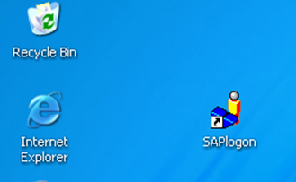
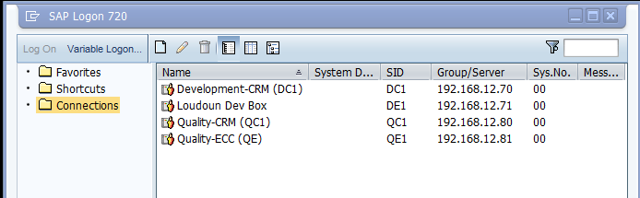
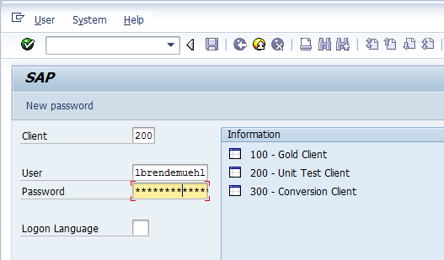
Log On to SAP
An SAP environment is a completely self-contained version of the SAP database, designated for a specific purpose.
SAP ECC is a client system. Each user session only accesses data on the client that you selected when you logged on.
Notes:
To log onto the SAP ECC system, begin by locating the SAP icon located on your desktop and double-clicking it. This will launch an SAP logon screen with various servers listed. You will be instructed as to which server to select, but a general rule will be to select the training server for training courses, and the production server for work assignments.
To select the server, either highlight it with a single mouse click and then click on the “logon” button, or double-click the server name. Selecting a server will launch the log on screen. On this screen, enter your assigned client number, user ID, and password. After each entry, press the <TAB> key to move the cursor to the next field. The additional field on this screen is for language, which has been defaulted to English and does not need to be filled in.
Should you wish to change the data in any field, defaulted or not, simply type over the existing entry.
Once you have entered the appropriate information, click Enter in the upper-left corner of the screen, or press the <ENTER> key on your computer keyboard.

Slide 36
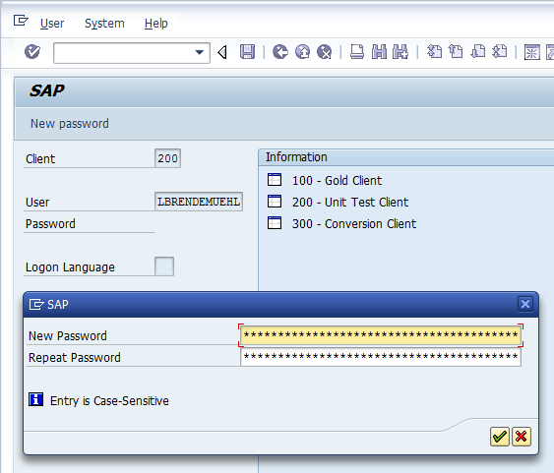
Resetting the Password
The first time you log onto SAP, you will be prompted to change your password. Upon successful authentication of your logon credentials, the SAP Easy Access screen will appear and you will have successfully entered SAP.
Notes:
The first time you logon, you create your own password. The next and subsequent times you logon, you will use the password created during the initial logon. When changing your password, please remember the following rules: Your new password must be between 5 and 8 characters. Do not begin with three identical characters, such as aaa or 333. Your password cannot contain any sequence of three characters that are contained in your user ID. Do not use a question mark, exclamation point, blank space, or the word pass. And your password is not case sensitive.
The first time you log onto SAP, a pop-up window will display prompting you for a new password. Enter the new password, in the case of training it would be “XXX” in the new password field. Enter the same password in the Repeat Password field, and then click the green check mark.
This action will generate a copyright notice in a pop-up window. Accept the terms by clicking the green check mark. This changes the password and launches the SAP Easy Access screen.

Slide 37

Demonstration
Activity Name: Log on to SAP
Transaction Name:
  N/A
  Transaction Code:
  N/A
  Path:
      SAP GUI > Training Client
Notes:
Show the SAP GUI; explain that it will be automatically installed on their computer workstations.
Show the server listings; explain how some are accessed by other means, for example, IC Web, SRM, ESS.
Highlight the Training server we will use in class.
Demonstrate how to log on. Click New Password and explain how they will automatically get the pop-up window when they log on for the first time but can also change it whenever they wish by clicking New Password.
Change the password, explain the guidelines for password selection.

Slide 38
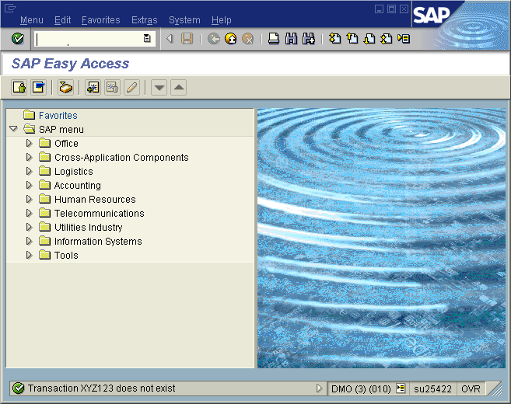
SAP Screen Features
A typical SAP screen has seven main areas:
Screen Header
Menu Bar
Standard Toolbar
Title Bar
Navigation Toolbar
Screen Body
Status Bar
Notes:
After logging on to the ECC system, you will first see the SAP Easy Access Menu Screen. It is from this screen that you will be able to enter a specific transaction to work.
Screen Header – Displays standard Windows buttons such as minimize, maximize, and close. On a PC, the Screen Header also contains the Stop Transaction button on the upper left corner. This button can be used for stopping transactions and reports that have already been run.
Menu Bar – Contains menus for the functional and administrative areas of the system. As you navigate through SAP screens, the options on the Menu Bar will change, but every Menu Bar will contain System and Help. Clicking on the System option on the Menu Bar opens a drop down menu of useful functions such as Create session, End session and Log off.
Standard Toolbar – Contains the Command field and the standard SAP Toolbar buttons.
Title Bar – Displays the name of the screen you are working on.
Navigation Toolbar – Contains the SAP Standard Menu, SAP User Menu buttons and Favorites. When you are in a transaction, the Navigation Toolbar is replaced by the Application Toolbar. The Application Toolbar provides quick access to commonly used functions.
Screen Body – Displays different elements depending on where you are in the system.
Status Bar – Located at the bottom of the SAP screen, displays system messages and other session information.

Slide 39
SAP Menu Toolbar
The Menu Bar contains menus for the functional and administrative areas of the system.
Help Menu
System Menu
As you navigate through SAP screens, the options on the Menu Bar will change, but every Menu Bar will contain System and Help.
Notes:
The Menu Bar contains menus which consist of sub-menus and/or functions that perform an action. Menus on your screen change depending on which application or task you are using. Consequently, you will see different menus as you work on different tasks. Two items however will not change on the menu bar and they are System and Help.
Menus contain sub-menus and functions. A sub-menu, which is “subordinate” to a menu function, will have an arrow to the right of the item. To display all the menus in a Menu Bar, click once with the left mouse button on a menu and drag the cursor across the menus in the Menu Bar.
You can select menus, sub-menus and functions with either the mouse or the keyboard. To select a menu using the mouse, click on the menu name you wish to select with the left mouse button. To select some functions, it may be necessary to first choose one or even two sub-menus first with the left mouse button. You can easily cancel, or close, any menu or sub-menus that you have selected by clicking once with the left mouse button outside of the menu or sub-menu.
To select a menu utilizing the keyboard, begin by pressing F10 and then use the arrow keys to mark and display the menu. You select a sub-menu and/or functions by marking them with the arrow keys and then pressing the <ENTER> key.

Slide 40
SAP Standard Toolbar
The Standard Toolbar contains the Command field and the standard SAP Toolbar buttons.
The SAP buttons displayed on the Toolbar provide quick access to commonly used SAP functions.
Exit
Continue Search
Enter
Save
Print
New Session
Command Field
Back
Find
Cancel
First, Next, Previous Last Pages
If a Toolbar button is gray it is not available for use on that particular screen.
Notes:
The Standard Toolbar contains many icons for performing common actions. Also located in the Standard Toolbar is the Command Field that is used for transaction codes, a topic yet to be discussed. The icons located in the Standard Toolbar remain the same in all applications. However, in some applications, the icons may not be available for use. They will be shaded out. By positioning the cursor over the icon in the Standard Toolbar and leaving it there, a small banner will appear with the name of the icon. Some of the banners will also provide the corresponding function key used to perform that function.

Slide 41
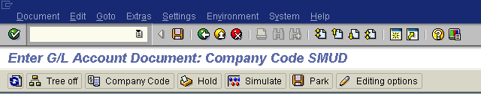
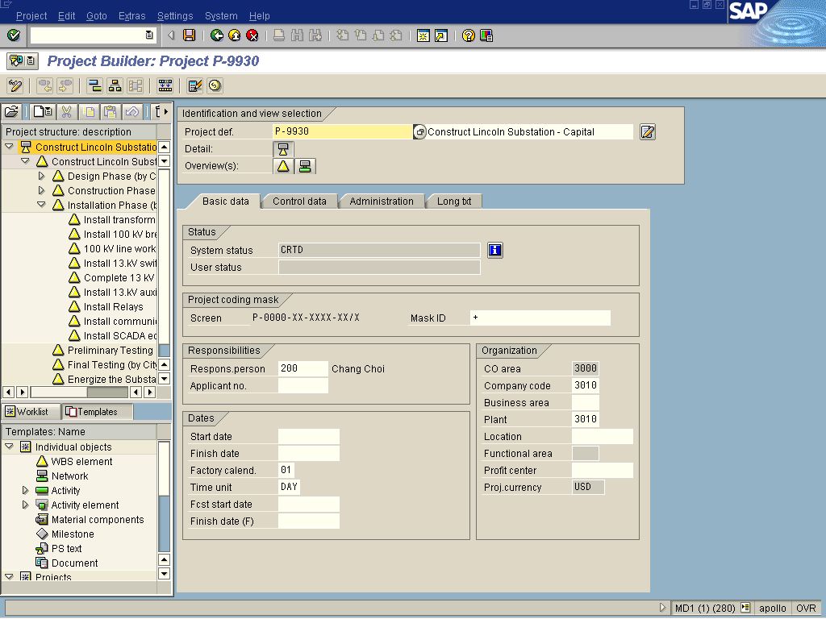
SAP Application Toolbar
The Application Toolbar is located directly below the screen title, in place of the Navigation Toolbar.
The Application Toolbar changes depending on the transaction you are in, providing unique functions.
Notes:
The SAP Application Toolbar contains buttons that duplicate functions available from the menu bar but provide quicker access to some of the most commonly used functions for the current screen and system tasks.

Slide 42
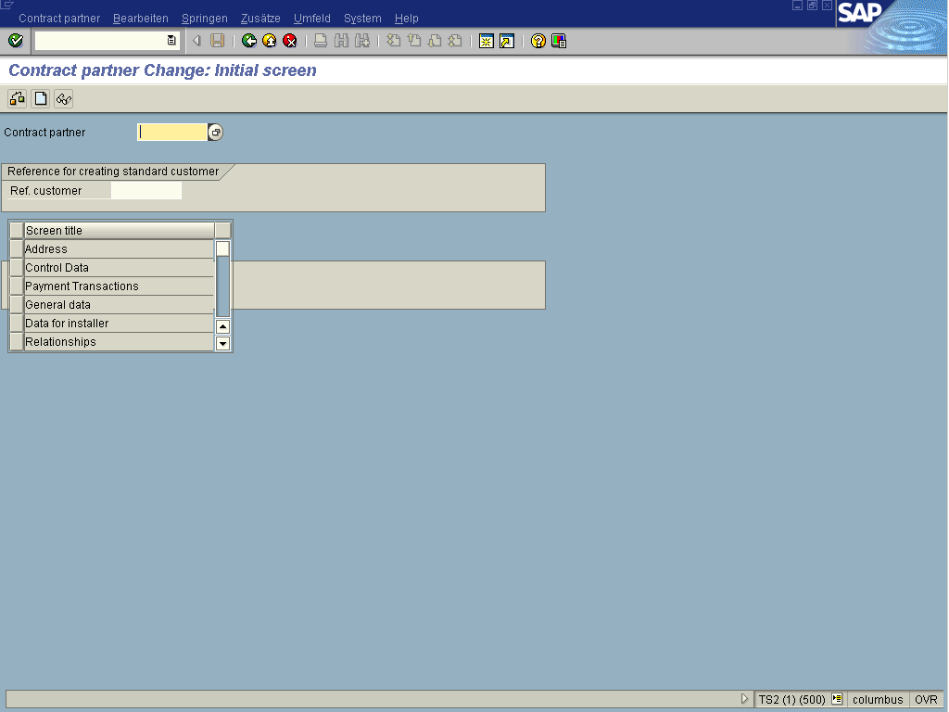
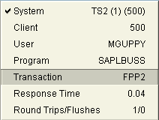
Status Bar
The Status Bar, located at the bottom of the SAP screen, displays system messages and other session information.
At the bottom right of the screen…
If you want to know what transaction you are in, click this button. Other system information is also available.
Notes:
System Messages – The large field to the left displays system messages including: warning messages, error messages or instructions, such as Make an entry in all required fields.
Double-click on the message or click in the red circle and a dialogue box pops up that explains the message and what action to take.
System Information – The second field on the status bar defaults to display the system information such as system name (session number) and (client number).

Slide 43
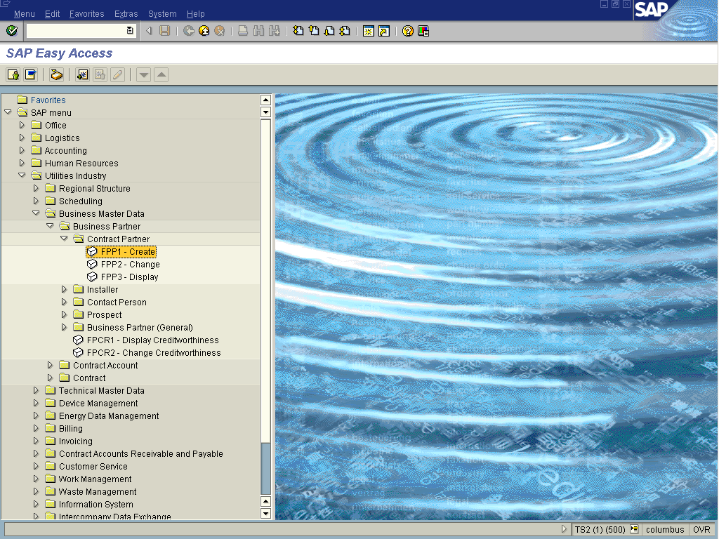
SAP Easy Access Menu
The SAP Menu appears as a tree structure on the left half of your screen immediately after logging in and is the default display on the SAP Easy Access screen.
There are two main menus you will encounter in SAP: the “SAP User menu” screen and the “SAP Standard menu” screen.
Use the SAP User Menu button or the SAP Standard Menu button to toggle between the two menus.
Notes:
SAP Standard Menu - After logging on to the ECC system, you will first see the SAP Easy Access Menu Screen. It is from this screen that you will be able to enter a specific transaction to work. In some instances, the menu will be collapsed. To expand the menu tree, click on the SAP Standard Menu icon. While all transactions will be displayed, you will only be able to access those transactions associated with your assigned role.
SAP User Menu - To initiate the requisite task to be performed, you must drill down into the tree structure of the SAP Easy Access screen to access transactions. Expand and collapse the menu tree structure either by clicking on the SAP Menu icon or by clicking on the triangles to the left of each folder. The Menu Tree Structure is organized in a hierarchical order, beginning with a listing of the various applications or modules. Each application expands to reveal a list of nodes or subfolders sectioning the application into various components. Under each node are specific transactions, and end the menu path for that transaction. Double clicking on the transaction will launch the appropriate initial screen for that transaction.

Slide 44
Transaction Codes
Each function in SAP ECC has a transaction code associated with it. Transaction codes are not displayed in the default view on the SAP Easy Access Menu, but you can enable this functionality.
The Navigation Area is made up of folders and sub-folders.
Click triangles to expand and collapse the menu tree to find the desired transaction.
Notes:
A transaction code or T-Code for short are letters, numbers, or both that make up a unique code that takes you directly to an application or the first screen of a task.
To use the Menu Tree to locate a transaction, from the SAP Easy Access screen, click on the SAP Menu icon to expand the SAP Standard menu tree. The first-level folders will be displayed; select the appropriate folder and double-click on the arrow next to it to expand it. Continue drilling down in this manner until SAP displays the transaction you are seeking. Once you arrive at the transaction, double-click on it to access the initial transaction screen.
Please note that while the standard menu displays all SAP transactions, you will only be able to access those transactions associated with your assigned role.

Slide 45
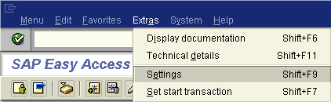
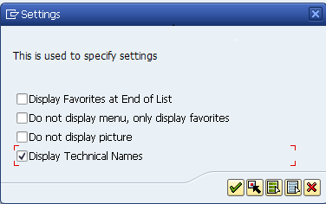
Display Transaction Codes in Menu
By default, transaction codes are not displayed in the menu tree when you log on. SAP provides the option to display the transaction code on the main menu screen.
Notes:
SAP provides the option to display the transaction code on the main menu screen. This procedure needs to be done only once, and once set will automatically display transaction codes in the Menu tree.
To show the transaction codes in your User menu, select the menu path Extras > Settings. Select the checkbox “Display technical names” Click Continue or press Enter on the keyboard. This action closes the menu and displays the transaction codes on an ongoing basis every time you log into SAP.

Slide 46
Demonstration
Activity Name: Navigate the SAP Easy Menu screen and display technical names of transactions.
Transaction Name:
  N/A
  Transaction Code:
  N/A
  Path:
      N/A
Notes:
Show the SAP Easy Menu screen and highlight the seven main areas.
Highlight the System Menu and Help Meu on the Menu bar. Show how to select sub-menus.
Highlight the Standard Toolbar and explain the buttons.
Highlight the Status Bar.
Toggle between the SAP Standard Menu and the SAP User Menu; show the differences.
Drill down into a menu tree, show transactions without transaction codes. Demonstrate how to display transaction codes in the tree structure.

Slide 47

Practice
Scenario:
Navigate between the SAP User Menu and the SAP Standard Menu, open and close menu folders, display transaction codes.
Replace to match Activity Guide
Exercise: 2.1 Log on to SAP and Navigate the
SAP Easy Access Menu

Slide 48
Check Your Understanding
True or False – Passwords must be between 5 and 8 characters and only contain letters OR numbers, not both.
Name the two menus that will always display on the Menu Toolbar, regardless of the transaction you are in.
Explain the difference between the SAP Standard Menu and the SAP User Menu.
Notes:
False. While passwords must be between 5 and 8 characters, they can be either letters, numbers, or a mixture of both.
System Menu and Help Menu
The SAP Standard Menu shows all transactions while the SAP User Menu shows only those transactions a user has the security role to execute.

Slide 49
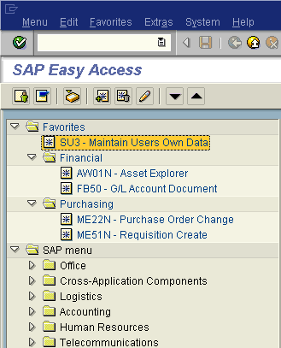
Working with Favorites
You may find that you frequently access the same transactions. Creating a Favorites folder allows you to get to those functions you use most often.
Rather than navigating through the SAP menu tabs each time or having to remember the transaction codes, you can store frequently used transactions in the Favorites folder.
The next time you need to use the transactions simply double-click it in the Favorites.
Notes:
SAP Favorites are menu shortcuts, similar to bookmarks on a web browser, to add the transactions and content you use most to a customized folder on the SAP Easy Access menu. Favorites are customized to each user and allow you to quickly access SAP transactions and reports you use most often. You can also add web pages and files on your network or computer hard drive.

Slide 50
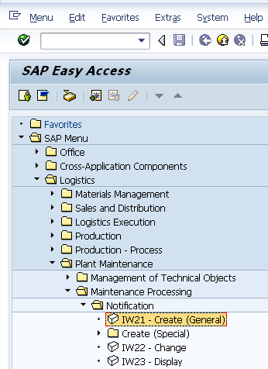
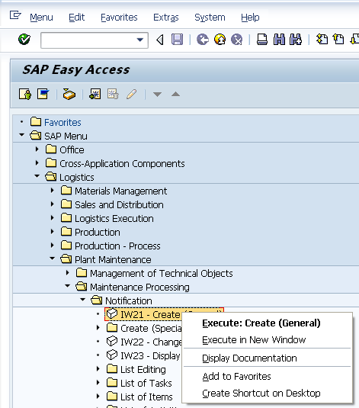
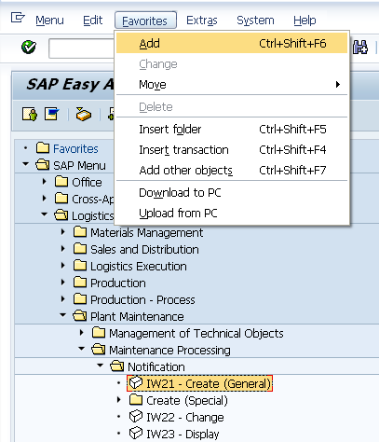
Adding Transactions to Favorites Folder
There are three ways to add transactions to a Favorites folder:
Using the main menu
Using right click
Using Drag and Drop

Slide 51
Demonstration
Activity Name: Create a Favorites Folder
Transaction Name:
  N/A
  Transaction Code:
  N/A
  Path:
      N/A
Notes:
From the SAP Menu screen, drill down into Logistics > Plant Maintenance > Maintenance Processing > Notification. Single click IW21 Create to highlight; click Favorites, click Add. Show how it was added to the Favorites folder.
From the SAP Menu screen, drill down into Logistics > Plant Maintenance > Maintenance Processing > Notification. Single click IW22 Change to highlight; right click to display menu, click Add to Favorites. Show how it was added to the Favorites folder.
From the SAP Menu screen, drill down into Logistics > Plant Maintenance > Maintenance Processing > Notification. Hold the mouse on IW23 Display and drag to the Favorites folder; release mouse. Show how it was added to the Favorites folder.
Demonstrate how to create a folder in Favorites and organize transactions. Right click on Favorites in the menu tree, click Insert Folder. In the pop-up screen, name the folder Notifications and click Accept. Drag and drop the 3 transactions into the Notifications folder.
Demonstrate how to add other items to a folder in Favorites. Right click the Notifications folder, click Add Other Objects. Explain all the options in the pop-up window. Double-click Web Address or File. In the Text field, name it News. In the Web Address or File field, type www.cnn.com. Click Accept. Show how it is now listed in Favorites. Click the link and show how the web site opens.

Slide 52
Practice
Scenario:
Create a Favorites folder, add, rename and delete transactions.
Show how to organize favorites.
Exercise: 2.2 Manage a Favorites folder

Slide 53
Check Your Understanding
What are Favorites?
Name the three ways you can add a transaction to a Favorites folder.
How many transactions can you have in a Favorites folder?
Notes:
Menu Shortcuts
Using the main menu, using right click, using drag and drop
As many as you wish

Slide 54
Multiple Sessions
You can open additional sessions of SAP, allowing you to work in different parts of the system without having to log on and off in the middle of a transaction.
Although it is possible to have up to six sessions running at a time, please only have two sessions open at any one time to minimize the impact on system resources.
Notes:
In SAP it tis possible to have two or more windows or sessions open at one time. This feature is useful in several situations, for example; you can view a repot in one window and a purchase requisition in another.
When you are finished with the second session and no longer need it, follow the menu path System>End Session from that session to close it.

Slide 55
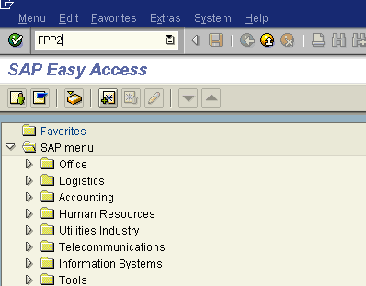
Executing a Transaction
Faster than drilling down through menu paths is using the transaction code directly into the Command Field.
Transaction codes and command codes are slightly different:
a transaction code is a unique identifier attached to each transaction in SAP
a command code is the text typed into the command field in order to access a transaction. It consists of the transaction code when the user is on the home screen or the transaction code and a prefix if the user is currently working within a transaction.
Notes:
From the SAP Easy Access screen, simply type the T-Code into the field and press the <ENTER> key or click on the green check mark at the upper right corner of the screen. You may also press CTRL + TAB, which will place the cursor in the Command Field.
If you are currently working in a transaction and want to end it and go to another transaction, type /n and the transaction code in the Command Field. For example, to enter the transaction for creating a Sales Order, VA01, you would enter /nVA01 and press the <ENTER> key or click on the green check mark at the upper right corner of the screen. The /n tells the SAP system that you wish to open a NEW transaction.
If you do not want to end your current task, but need to perform another task, you can create a new session – an additional ECC window that can open when you want to work on more than one task at a time. For example, suppose you are creating a Sales order and you need to look at a table of exchange rates. You can start a new session to look for the exchange rate table without having to end your first task of create the Sales order.

Slide 56
Using Commands to Launch Transactions
You can open additional sessions of SAP by using a prefix, allowing you to work in different parts of the system without having to log on and off in the middle of a transaction.
<transaction code> | Takes you to the associated transaction from the SAP Easy Access Menu
“/N” | Ends the current transaction and returns you the main SAP Easy Access Menu
“/n<transaction code>” | Ends the current transaction and starts the new specified transaction
“/o” | Displays an overview of the open sessions
“/o<transaction code>” | Starts a new session with the specified transaction while keeping the current session open
“/l” | Closes the active session
“/Nend” | Ends the current transaction and prompts you to log off of SAP
Notes:
SAP only recognizes transaction codes when used with prefixes. Prefixes determine the way in which SAP will access the indicated transaction.
In the ECC system, you can create a session and start a task in one step by using a transaction code. When you open a session with a transaction code, the system displays the initial screen of the task in the new session. To use this method, enter /o (OH, not zero) followed by the transaction code.
The system opens an additional window for the new session and displays the initial screen of the transaction entered. The system places the new window in front of all the other windows on your computer screen. The new session becomes the active session and remains as such until you move to a different session. You may move between sessions by holding the ALT key down and then pressing on the TAB key.

Slide 57
Demonstration
Activity Name: Launch a transaction using various methods. Open a second session.
Transaction Name:
  TBD
  Transaction Code:
  TBD
  Path:
      TBD
Notes:
From the SAP Easy Access screen, type FBL1N in the Command field and press Enter.
In the Vendor Account field, enter 3100000005 and click Execute.
Explain that you wish to leave this transaction and go to another transaction. In the Command field, type /nFK10N and press Enter.
Show that you still have a single session, the system exited the previous transaction and launched a new one. Now explain that you are going to show how to open a new session and move to a new transaction while keeping the old one open.
In the Command field, type /oFBL1N and press Enter. Show the two screens.
Finally, explain that you are going to close one session while leaving the other open. Click System, End Session.

Slide 58
Practice
Scenario:
Launch a transaction:
By menu path, by entering in command field, by using command code.
Exercise: 2.3 Launch a Transaction

Slide 59
Check Your Understanding
How many SAP sessions can you have open at one time?
What is the preferred maximum number of sessions to have open at one time?
Explain the difference between a transaction code and a command code.
Notes:
Up to six sessions.
No more than two sessions.
A transaction code is a unique identifier attached to each transaction in SAP while a command code is the text typed into the command field in order to access a transaction.

Slide 60
Check Your Understanding – Extra Credit
Identify the indicated parts of the screen.
A
B
C
D
Notes:
A-Standard Toolbar
B-Application Toolbar
C-Screen Body
D-Status Bar

Slide 61
Questions
What other questions do you have?

Slide 62
Module Summary
Having completed this module, you should be able to:
Log on to SAP ECC
Recognize typical ECC screen features
Recognize standard SAP buttons and icons
Differentiate between the SAP content menus
List and use the navigation methods to initiate a transaction in the SAP ECC system
Create and organize a Favorites folder

Slide 63
Navigating in SAP ECC
Module 3

Slide 64
Module Objectives
Upon completion of this module, you should be able to:
List the steps involved in processing a transaction
Explain the different types of fields in SAP
Enter data in fields
Search for data using matchcodes
Recognize SAP search screen features
Explain when and how to use the search functionality
Interpret system messages
Notes:
This module introduces you to basic SAP search fundamentals, including the basic search screens and a variety of search functions that you will use frequently. SAP provides its users with powerful search options and understanding the skills presented in this module is a necessary and usefl tool for using SAP.

Slide 65
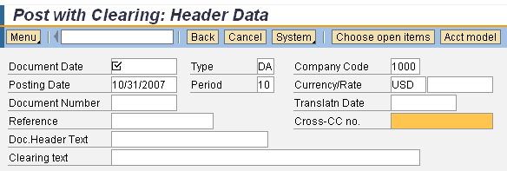
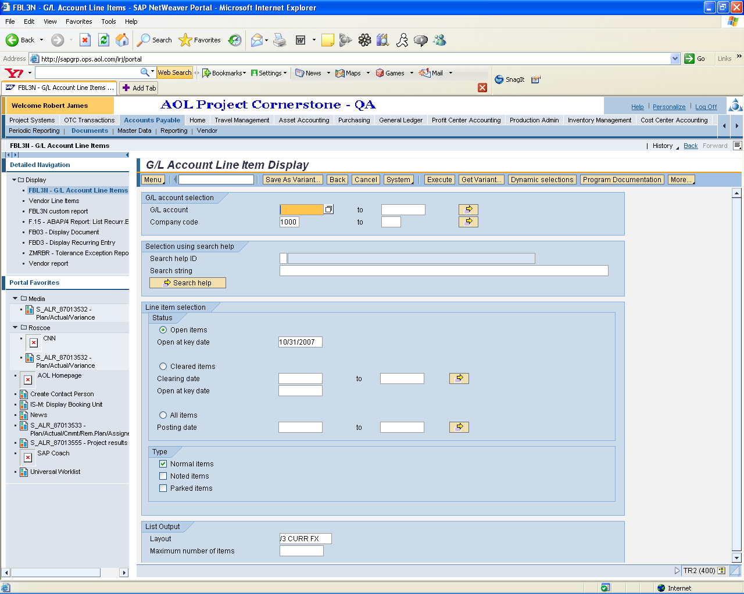
Entering Transactional Data
The data needed to process a transaction may be required, optional or display only.
The checkmark indicates that this field is required.
If you do not enter information in a required field, SAP will prompt you with an error message.
If a screen does not have any required fields, you can go to the next screen without entering data.
Some screens, however, have required fields that are not marked. These fields are called conditional fields because whether they are required or not is conditional upon how other fields or options are filled out.
Notes:
In SAP you enter data in specified areas called fields. A field is a “holding place” for each piece of information on a document. When you type information in a field, it is stored in that document and can later be accessed from the database.
There are three field types: Required Default, and Optional:
Required Entry fields are usually flagged with a checked box. This means that correct or relevant data must be entered in the field before continuing on to other fields or tasks. While some fields are Loudoun Water required and others are SAP required. SAP required fields are indicated with a checkmark in the field.
Default Entry fields already have a system entry. However, you may be able to overwrite the system entry depending on the system task and / or your SAP profile.
Optional Entry fields are those in which you may enter data, but an entry is not required by the system in order to proceed with a system task. Some Optional Entry fields may become required depending on the values entered in other fields.

Slide 66
Entering Transactional Data
The data needed to process a transaction may be required, optional or display only.
Certain fields have additional search functionality, referred to as a matchcode.
Fields with a matchcode are easily identifiable. Click in the field to see if the matchcode symbol appears.

Slide 67
Entering Transactional Data
The data needed to process a transaction may be required, optional or display only.
When you access an SAP screen, you may find that some fields already contain data. SAP defaults this data as a shortcut, but if the field appears as white, you may modify the data in the field.
If the field is gray, you are not able to change the defaulted data.

Slide 68
Types of SAP Fields
As you navigate through SAP, you will notice different types of data entry fields on the screen.
Check Boxes
Radio Buttons
Data Entry Fields
Notes:
Check Boxes - You can check one or more items in a group of options. SAP will display data relevant to the checked items.
Radio Buttons - You can select only one option in a group of options.
Data Entry Fields – Require a match to data in the system. If you do not know the exact data, such as an account number, use the matchcode function to search for it.

Slide 69
Data Entry Fields
System Defined | User Defined
Provides a field in which you select from a list of possible values When you click in this type of field, the matchcode icon will appear You can click the matchcode to search from a list of possible values You can also manually type in a value in this field, but it must exactly match an entry in the list of possible values | Provides field in which you can enter any value you want When you click in this type of field, no symbol appears You cannot select a value from a list of possible values. You can manually type in any value
Notes:
If a field has a Matchcode option, you will see a Matchcode Icon at the right side of the field when you click on it. Depending on how many entry options exist for that field, the system displays one of the following:
A simple list of possible entries, e.g., Personnel Area
A graphical selection tool, e.g., a calendar to select a date
A Search help selection window

Slide 70
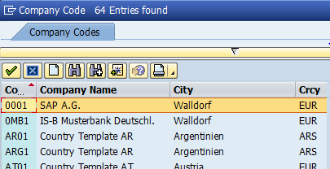
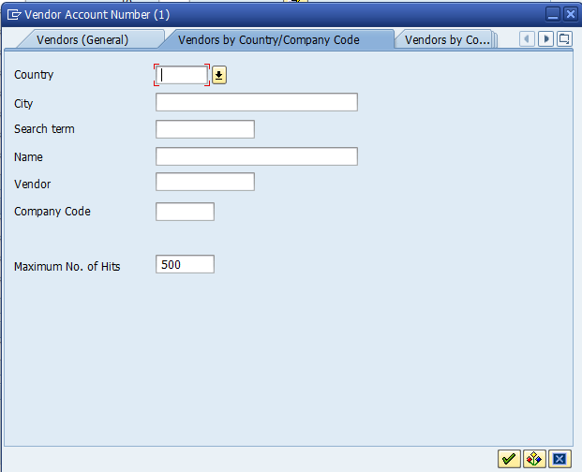
Search for System-Defined Data
When you click a matchcode you can get two types of results:
  A Search Help – List with a limited number of possible values. Double-click the value you want and it will default in the field
  A Search Help – Help dialog box for fields with a vast number of values to narrow the search for data
Search Help - List
Search Help - Help
Notes:
In many cases, SAP requires the entry of a numerical code such as a Vendor ID number or G/L account number to indicate the particular record that you wish to look up. Because SAP users cannot remember all of these thousands of entry options, SAP offers a variety of search functions to assist users in finding the values they need.
The Matchcode function allows you to select from a list of possible entries for a field if the list is short enough, or if the available list is too numerous to display, to search for information in a variety of ways.

Slide 71
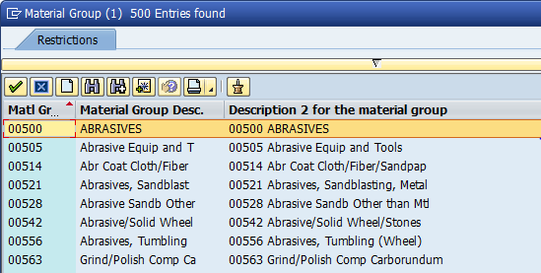
Personal Settings for Search Help - List
You may establish a favorites list for the values you most commonly use in most Search Help lists.
This eliminates the need to scroll through multiple options, such as search for cost centers or company codes, when you commonly use just a few values.
Display a Search Help List
1
3
Click Insert in Personal List button.
2
Highlight an option by single-clicking on it.
Notes:
Once you have created a Favorites list, it will automatically display from any transaction with that field. For example, Material Group appears in a number of transactions; any time you click the matchcode button in that field, your favorites list will display. You can toggle between your favorites list and the master list, and add/delete items at any time.

Slide 72
Demonstration
Activity Name: Display a Search Help – List and create a Personal list
Transaction Name:
  N/A
  Transaction Code:
  N/A
  Path:
      N/A
Notes:
Execute transaction FAGLB03. Click the matchcode for Account Number.
Demonstrate the quick tab function. Select search option G/L Account Number in Company Code.
Click OK. Show how long the list is by scrolling down. Explain how most managers/users will want a list of the G/L accounts they will use most often.
Highlight a line item; click Insert in Personal List. Do several options, then click Personal Value List to show the results.
Click Copy to return to the main screen, then click the matchcode again for Account Number. Show how only the Personal list displays; click Show All Values to demonstrate how to get back to the selection screen.

Slide 73
Practice
Scenario:
You often search for G/L account numbers and would like to create a Personal List for just the G/L account numbers you use most often.
Exercise: 3.1 Create a Personal List

Slide 74
Check Your Understanding
True or False - You must enter data in all fields on a screen before moving on to the next screen.
True or False – if a field already contains data when you access the transaction, you cannot change it.
What type of field allows you to select more than one item or group of options?
Name the two types of results you get when you click a matchcode.
Notes:
False. You only need to enter data in required fields.
False. If the field appears as white, you may modify the data in the field.
Check boxes.
Search Help – List and Search Help – Help.

Slide 75
Search Help - Help
When you click in a field that has a vast number of values, you get a dialog box that allows you to narrow down the list of entries.
This type of search uses the matchcode functionality that allows you to restrict the data
A matchcode is a search tool that allows you to locate data by entering information contained in the record
  For example, you can search for a customer number by using the customer’s name as a search criteria
Some search fields are free text, while others allow you to select from a list of categories.
Maximum No. of Hits – This field defaults to 500, indicating that only the first 500 values that meet the search criteria will appear in the search results. You can change this number. However, be aware that increasing this number may slow the system’s performance.
Notes:
Some search fields are free text, while others allow you to select from a list of categories.
For example, you may change the Category, Vendor, or Purch. Organization to search by a specified list of options, but use free text in the Search term, City, or Postal Code fields.
The search feature is useful when the list of possible values is too long

Slide 76
Wildcard Search
Wildcard (asterisk *) placement determines the search results.
*sentry* | Wildcards before and after the search term displays vendors that contains sentry ANYWHERE in the name. In other words, you do not know what comes before sentry and you do not know what comes after sentry.
*sentry | Wildcard before the search term displays vendors where the word sentry is NOT the first word in the vendor name – (unless Sentry is the only word).
sentry* | Wildcard after the search term displays vendors where the word sentry IS the first word.
Notes:
When performing a Search Help – Search you must type the exact search term (word or series of words) to produce accurate search results.
You may not always know the exact search term.
For example, when searching for the vendor known as Sentry Security Systems, you may not know exactly how that name appears in SAP.
Sentry or Sentry Security or Sentry Security Systems
Wildcard (asterisk *) represent the unknown portions of the search term. Use a wildcard to help you search in SAP.

Slide 77
Demonstration
Activity Name: Execute a Search using Search Help - Help
Transaction Name:
  N/A
  Transaction Code:
  N/A
  Path:
      N/A
Notes:
Launch transaction code ZPS028 (Project Inspection Report). Click in the Project Definition field, then click the matchcode.
In the Description field, type *Ald* and click Accept.
Show the displayed option, pointing out the misspelling and the entire name.
Double click the option to populate the report.

Slide 78
Practice
Scenario:
Search Help – Help wildcard search.
Exercise: 3.2 Use Search Help – Help

Slide 79
Check Your Understanding
What is the maximum number of hits the system defaults to for a search?
What do wildcards represent?
Notes:
500, but you can change it.
The unknown portions of the search term.

Slide 80
System Messages
 | Success or Information message regarding the procedure performed. No action needed.
 | Warning message indicating that something might need to be addressed. This generally displays on screens where you enter a date. If the date entered falls on a weekend, the system displays a warning message to alert you. Press Enter to acknowledge the message.
 | Error message indicating that information is missing from a required field or that incorrect information has been entered. You may not proceed until the data has been corrected or entered.
Notes:
Sometimes if you do not enter the correct type of information, SAP may prompt you with system messages.
There are three types of system messages that you may see.

Slide 81
Status levels
 | The red light indicates that the process is not complete and something within the content area must be correct before proceeding.
 | The yellow light indicates that there is a potential problem with the data in the process area and you might not be able to proceed.
 | The green light indicates that everything in the content area is correct and you may proceed with the rest of the process.
Notes:
There are some transactions within SAP that have status levels. Those statuses are indicated by a traffic light. The colors in the SAP traffic light have the same meaning as a real traffic light.

Slide 82
Questions
What other questions do you have?

Slide 83
Module Summary
Having completed this module, you should be able to:
List the steps involved in processing a transaction
Explain the different types of fields in SAP
Enter data in fields
Search for data using matchcodes
Recognize SAP search screen features
Explain when and how to use the search functionality
Interpret system messages

Slide 84
The SAP Business Workplace
Module 4

Slide 85
Module Objectives
Upon completion of this module, you should be able to:
Describe the functionality of the SAP Business Workplace
Add a note to a workflow item
Forward a workflow item to another person
Approve and reject workflow items
Create a Passive delegate

Slide 86
ECC Business Workplace
The Business Workplace provides a standard working environment in which SAP approvers carry out their share of the business and communication processes in.
When an item requires attention, a notice will be sent to your Outlook account
You must log into ECC and manage Inbox items from the Business Workplace
Items will remain in your Inbox until you approve or reject them but once approved will continue the workflow process based on the type of item it is
Notes:
During the Land Development Process, the Developer submits the Bond, Agreement, Deeds and Easements etc. when required. With SAP the internal approval process will move inside SAP to track who approved, when it got approved etc. In addition, certain Purchase Requisitions created for Capital Projects will be approved from the ECC Business Workplace.
The process for approving Purchase Requisitions created from Capital Projects is different than approving general shopping cart requests. As Project-related Purchase Requisitions are created, they will require different levels of approval. Depending on your approval authority, purchase requisitions will be routed to your SAP inbox and will processing before they can move to the next level of approval in the process.

Slide 87




The Workflow Process
High dollar items may require a third-level approval, depending on the approval authority of the second-level manager.
Approving Manager
Depending on the task or dollar amount involved, the actions of the first-level approving manager may trigger the item to workflow to the second-level approving manager.
Approving Manager
The item needing approval will workflow to the employee’s immediate approving manager, according to the organizational or task hierarchy.
Approving Manager
Workflow is triggered when an employee completes a task, such as creating a purchase requisition against a Capital project.
Employee
Notes:
Workflow is a set of rules that determine the path a particular process will take.
Workflow tasks are the steps in the process which have to be performed either by people or automatically by SAP.
A work item is the specific task that displays in the Business Workplace Worklist for a person to perform.

Slide 88
Business Workplace vs. Outlook Notifications
Business Workplace Worklist
E-Mail Notifications
Brings work to you.
Only way to remove a work item is to complete the work or forward to another person.
Workflow process stops until task is completed and automatically triggers the next step.
History log of all steps taken in the workflow process available to review.
Tells you what work needs to be done.
Remove e-mail notification by deleting item.
Process could continue without an approval level being completed.
No record of any other action taken in the process if e-mail was sent to more than one person.

Slide 89

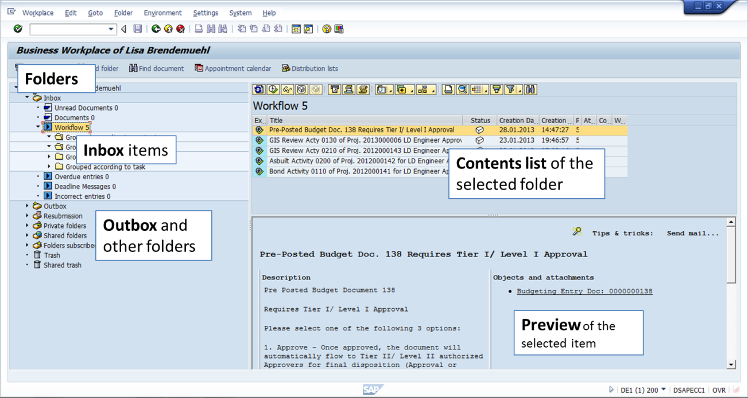
Accessing Business Workplace
1
From the SAP Easy Access screen, click the Business Workplace button.
The Business Workplace screen is divided into three sections:
Folders – The folders of your Business Workplace are displayed here in a tree structure. By clicking on a folder you call the contents of that folder.
Contents List – A list is displayed here of all the documents, distribution lists, folders and objects contained in the folder that you have selected in the folder tree.
Preview - The list entry that is selected in the folder contents list is displayed here, provided that the entry supports the preview
Notes:
You can also access the Business Workplace by using transaction code SBWP.

Slide 90
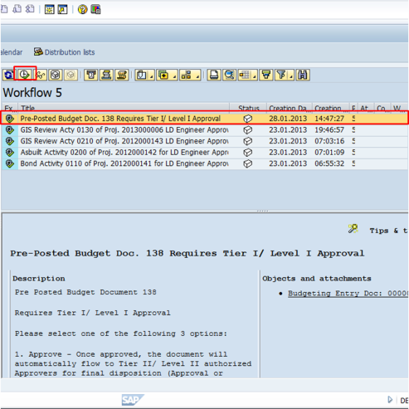
Selecting Inbox Items
Expanding the Inbox menu tree will display the Workflow folder.
Once the Workflow folder is selected, the items awaiting approval are listed in the Contents list.
Highlighting an item will display additional details about that item in the Details pane.
Double-clicking on a link will open any attachment or document related to the item. This allows you to further review it prior to taking action.
To process the item, click Execute .
4
1
2
3

Slide 91
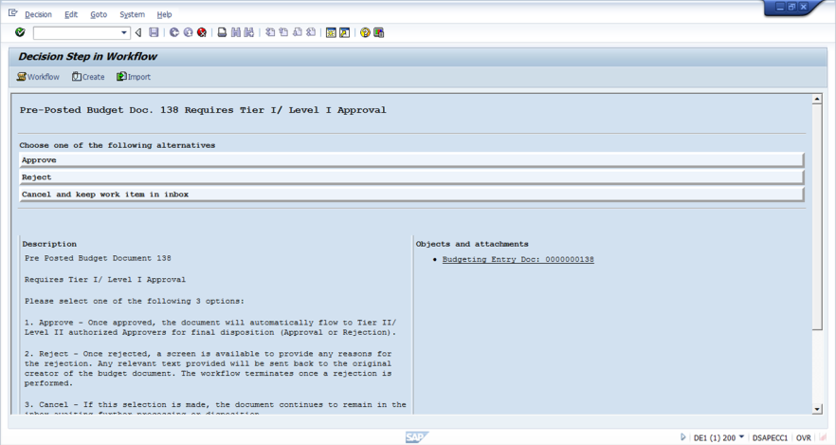
Processing an Inbox Item
The Decision Step in Workflow screen provides several options
You many click any link to view additional documentation.
You may view the workflow approvers by clicking Workflow.
You may add a note or document by clicking Create.
You can Approve or Reject, or Cancel the action, by clicking the appropriate button.
2
3
4
1
Once an item is approved, it automatically flows to the next person’s Inbox and an email notification is sent to their Outlook Account. If rejected, it flows back to the previous person.

Slide 92
Demonstration
Activity Name: Process items in the Business Workplace Inbox.
Transaction Name:
  N/A
  Transaction Code:
  N/A
  Path:
      N/A
Notes:
Complete section once training client is set up.

Slide 93
Practice
Scenario:
Complete tasks in the Business Workplace Inbox.
Exercise: 4.1 Process Items in Business
Workplace Inbox

Slide 94
Check Your Understanding
True or False – All items needing approval will come to your ECC Business Workplace Inbox.
True or False – The only way to remove a work item is to complete the work or forward to another person.
What happens when you approve an item in your Inbox?
Notes:
False. Time approvals are done in MSS and general Shopping Carts are approved in SRM. Only ECC-generated items requiring approval will be routed to your Business Workplace Inbox.
True.
It automatically flows to the next person in the approval hierarchy, unless you are the last approver.

Slide 95

Workflow Process with Passive Delegation
Third Approval Level
3
The Passive Delegation can remain in effect, and the substitute will have the ability to adopt the worklist items whenever necessary.
Second Approval Level
2
The substitute must adopt the worklist items of the approver in order to manage worklist items. Once approved, if the item needs additional approval it will workflow according to the hierarchy of the cost center assigned to the item.
First Approval Level
Substitute Approval
Adopt
1
Employee
When an item is created and released for approval, it will workflow to assigned approver.
Notes:
A passive delegation is essentially a substitution on request. The delegate is always on “stand by” to approve for you in times of unexpected absences.
You set up the passive delegate but worklist items do not flow to the delegate’s inbox; the delegate must go into SAP and take over your worklist items in order to approve or reject a task.
It is highly recommended that every approving manager have at least one passive delegation set up to cover for them in the event of unplanned absence
Your delegate will have the ability to adopt or take over your worklist items at anytime

Slide 96
Workflow with Active Delegation
Third Approval Level
3
Upon return, the approving manager must end the substitution in order to stop the items from flowing to both inboxes. The substitute will no longer have the ability to access and approve or reject worklist items.
Second Approval Level
2
The substitute approves the item from his/her inbox. If additional approvals are required, it will workflow according to the hierarchy of the cost center the item is assigned to.
First Approval Level
Substitute Approval
Delegation
1
Employee
When an item requiring approval is created and released, it will workflow to both the approver and the substitute.
Notes:
An Active Delegation is used for planned absences such as vacation or extended leave.
When in effect, work items in your inbox are automatically available in your delegate’s inbox as well:
When the worklist item is acted upon by one person it will disappear from both inboxes
You must end the delegation in order to stop worklist items from flowing to both inboxes
Your delegate will not be able to access your worklist items until you turn the activation back on at a later date

Slide 97
Demonstration
Activity Name: Create a Passive Delegate. Activate a Passive Delegate.
Transaction Name:
  N/A
  Transaction Code:
  N/A
  Path:
      N/A
Notes:
Complete section once training client is set up.

Slide 98
Practice
Scenario:
Create a Passive Delegate. Activate a Passive Delegate.
Exercise: 4.3 Set Up a Passive Delegate

Slide 99
Check Your Understanding
How many Passive delegates can you have at a single time?
What are the benefits of having a substitute to manage items in your Inbox?
Notes:
As many as you would like.
Solicit answers from audience – you may be surprised at what you get.

Slide 100
Questions
What other questions do you have?

Slide 101
Module Summary
Having completed this module, you should be able to:
Describe the functionality of the SAP Business Workplace
Add a note to a workflow item
Forward a workflow item to another person
Approve and reject workflow items
Create a Passive delegate

Slide 102
Report Features and Tools
Module 5

Slide 103
Module Objectives
Upon completion of this module, you should be able to:
Describe ECC Reports
Describe types of reports available
Access reports using a menu path or transaction code
Enter selection criteria for a report
Create and use variants
Execute reports
Customize report data (filter, sort, subtotal, etc.)
Drill down to a source document from a report
Modify the layout of the report data
Print reports in both foreground and background
Notes:
You will learn more about specific reports in other sessions you are registered for; this course covers the fundamentals of how you access and display reports. The skills you learn in this course will help you in your next courses as you start to see the various reports you now have access to.

Slide 104
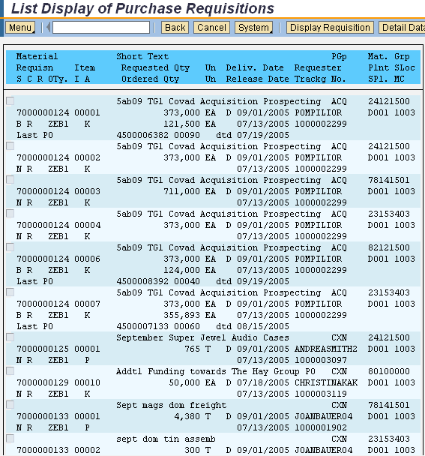

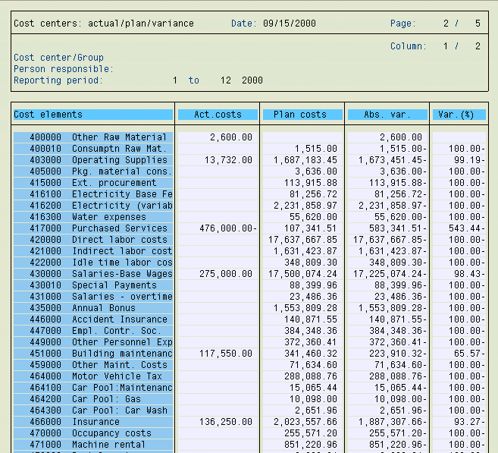

SAP ECC Reports
SAP ECC reports contain real-time data:
  Data in SAP ECC reports is up-to-date at any given time and reflects all posting activities as soon as they occur.
  Reports in SAP ECC are organized by modules and applications.
  You can access reports by navigating the SAP menu tabs or by using transaction codes.
  Access to reports is restricted by the role(s) assigned to the user.
List Display
Purchase Requisitions
Cost Center
Report
ECC Purchasing
Reporting
ECC Cost Center
Reporting
Notes:
You can add reports you use most often to your Favorites folder.
Access to reports is restricted by the role(s) assigned to the user – for example, not everyone will have the ability to generate capital project reports. And for those that will be able to generate budget reports, your access will be limited to just your department. You will not be able to see another department’s budget.

Slide 105
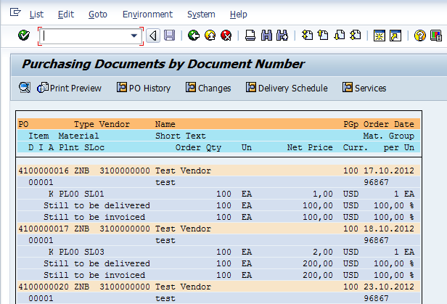
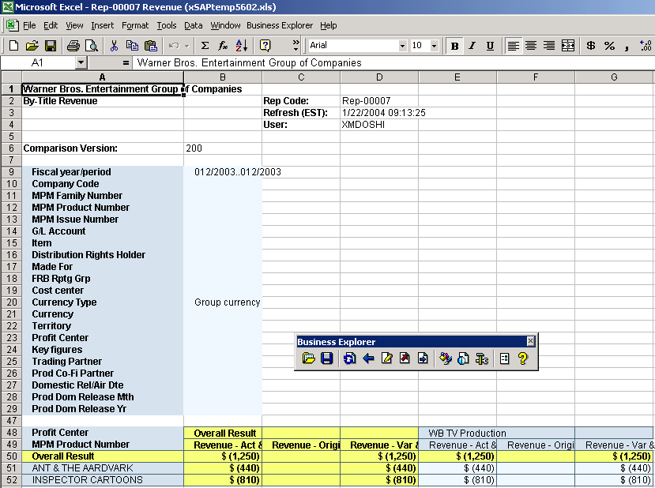
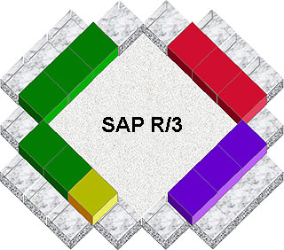
Types of SAP Reports
There are three types of reports:
Reports
1. SAP ECC Standard Reports
3. Business Intelligence (BI) Reports
2. Loudoun Water Customized Reports
MM
FI
CO
BI
AA
SAP ECC
Data flows from SAP to BI at pre-determined intervals
Real Time
PS
Not Real Time
External Applications
Notes:
Both standard and Loudoun Water-customized reports are located in the SAP menu tree
Your ability to access specific reports is based on your SAP role and security level
Reports are grouped in a logical manner to the business process the report is tied to
For example, Vendor Payment reports are listed under the Accounts Payable tab; Depreciation reports are listed under the Asset Accounting tab, etc.
BI reports, on the other hand, aggregate data over a period of time and provide static reports and statistical dashboard views.

Slide 106
SAP ECC and BI Reports
SAP ECC Reports SAP BI Reports
Contain data from across modules of SAP ECC and SRM
Contain transaction level data
Contain line item details
Contain real-time data that is up-to-date at any given time
Contain data from across modules of SAP ECC and SRM, as well as from non-SAP data sources
Provide data for management reporting
Contain summarized data
Contain data that is extracted from SAP ECC and other programs at scheduled intervals to support period close activities

Slide 107
Demonstration
Activity Name: Access an SAP ECC Report
Transaction Name:
  List of Vendor Line Items
  Transaction Code:
  S_ALR_87012104
  Path:
      Accounting > Financial Accounting >
      Accounts Payable > Information
      System > Reports for Accounts
      Payable Accounting > Vendors: Items
Notes:
You may wish to point out how long the path is to again stress using transaction codes and moving transactions into Favorites Folder.
Execute transaction.
Explain that all ECC reports first display a screen where the user can add search criteria to narrow search results, and we will be going over all the options in greater detail.
Enter 3000000000 (3000 000 000) in the Vendor Account field and click Execute.
Show the results.
Explain that the next exercise is just to have them execute a report, stress again that the next hour will be spent going over the fields in detail.

Slide 108
Practice
Scenario:
  You have logged on to SAP. You need to run a report that displays invoices that have been cleared for selected vendors
  Use the SAP menu tabs to find the S_ALR_ 87012104 List of Vendor Line Item report that allows you to view cleared line items by vendor
  You wish to move to transaction FBL1N Vendor Line Item Display.
Exercise: 5.1 Access an SAP ECC Report

Slide 109
Check Your Understanding
True or False - SAP ECC reports provide real-time data, including from external applications.
Dashboard reports aggregate data from what source?
Notes:
False. SAP ECC reports provide real-time data from ECC only. External applications do not synch data to SAP ECC.
Dashboard reports are Business Intelligence reports that aggregate static data from SAP and external applications.

Slide 110
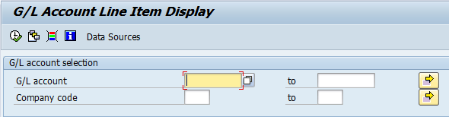
Enter Selection Criteria
Once you select the report that you want to run, you will need to define the type and amount of information you want to be displayed in the report:
  Selection criteria are fields that you can use to enter values for retrieving data for the report
  Selection criteria fields will vary depending upon the report you select
  Only data that matches the selection criteria will be displayed in the report
Selection criteria field options will change depending on the report you are generating
Notes:
The use of selection criteria offers the following benefits:
You can limit the length of the report
You can minimize the processing time needed by SAP for data retrieval
You can extract relevant data and exclude unwanted data
Because of the wealth of data in the SAP system, be very cautious of generating reports with vast amounts of data by using few or no selection criteria.

Slide 111
Using the Multiple Selection Option
One of the reporting tools used to produce very specific report results is the Multiple Selection button.
The Multiple Selection button allows you to enter very specific selection criteria to narrow the report results
Only use the multiple selection tools when you have a clear understanding of the data because the advanced selection tools are so specific that all criteria must be true to generate report results
In the Multiple Selection Criteria tabs you may include, exclude, or add operators to your specific selections

Slide 112
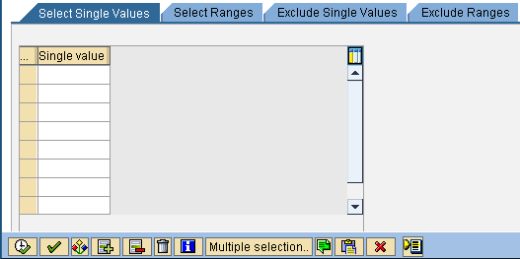
Multiple Selection Buttons
There are a four tabs and a number of buttons on the Multiple Selection dialog box to provide additional functionality.
Mix and match these multiple selection options to produce a complex and very specific search for report or query data.

Slide 113
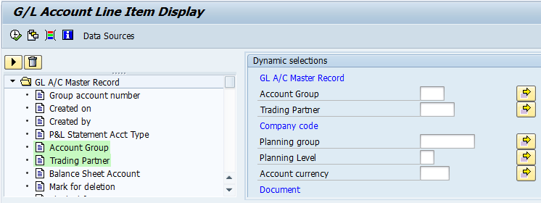
Specify Additional Selection Criteria
In addition to the selection criteria that are displayed on the screen, some reports allow you to specify additional fields that you can use as selection criteria via the Dynamic Selection option.
1
Click on the initial screen to display the Dynamic Selections
3
The selected field(s) will appear on the screen. You can now enter values in these fields.
2
Double-click the field(s) you want to use as selection criteria.
Fields already selected are highlight in green; double-click to remove as selection criteria.
4
Click to return to the initial selection screen.

Slide 114
Demonstration
Activity Name: Enter Selection Criteria
Transaction Name:
  TBD
  Transaction Code:
  TBD
  Path:
      TBD
Notes:
Once training client is set up, find report with multiple data points to select from. Show Multiple Selection options, Dynamic Selections.

Slide 115
Practice
  Scenario:
  You accessed the FBL1N Vendor Line Item Display report to view open items by Vendor Account numbers
  You need to enter the selection criteria so that you can display cleared invoices for selected vendors
  Vendor Account numbers include specific account numbers as well as a range of vendor numbers for Company Code 1000
Exercise: 5.2 Enter Selection Criteria
Notes:
May need to find another report.

Slide 116
Check Your Understanding
True or False – it is not necessary to enter selection criteria in order to generate report results.
What allows you to enter very specific criteria to narrow report results?
How do you add additional search fields to the selection criteria screen of a report?
Notes:
True. While you can generate a report with vast amounts of data, it is not recommended as it can tie up system resources significantly.
The Multiple Selection function.
The Dynamic Selection option.

Slide 117
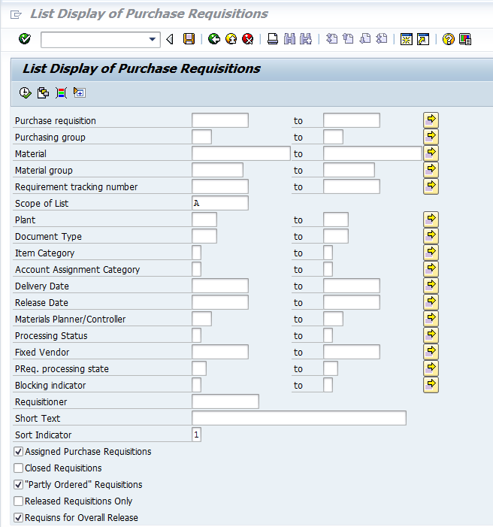
Selection Variants
One Report
Three Viewers
Three Different Views
View by Open Purchase Requisitions
Buyer
Capital Project Manager
View Purchase Requisitions by WBS Element
View by Closed Purchase Requisitions
Department Manager
Notes:
Before you execute the report, you can save the values that you enter in the selection criteria fields as a Selection Variant.
A selection variant is a group of selection criteria values that have been saved for future use.
You can “recall” the variant of saved values at a later time without having to enter the values each time you want to run the report.
When you select a saved variant, the selection criteria values will automatically default in the selection screen.
By adding a forward slash (/) in front of the variant name you can allow others to use your variant. This is called a Global Variant.
A report can have several different variants, with each variant retrieving different types of information.

Slide 118
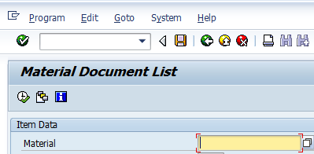
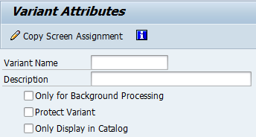
Create a Selection Variant
Complete the following steps to create a selection variant after you have entered your selection criteria values.
1
Select Goto ➔ Variants ➔ Save as Variant…or press Ctrl+S to save selection criteria values as a variant.
3
2
Click to save the variant.
Enter a Variant name and description. You can enter any name and description as long as it is within the character limits of the field.
It is recommended that each Business Unit develop a naming convention for variants.
Checking the Protect Variant box when creating a Global Variant will prevent others from inadvertently changing your variant. Only the owner of a variant (the creator) will be able to make changes.

Slide 119
Demonstration
Activity Name: Create a Selection Variant
Transaction Name:
  TBD
  Transaction Code:
  TBD
  Path:
      TBD
Notes:
Will need to identify criteria once training client is built.

Slide 120
Practice
  Scenario:
  As part of your duties you monitor purchasing documents for a select set of vendors. To facilitate this process, you wish to create a Selection Variant.
  You will enter selection criteria in the ME2L Purchasing Documents per Vendor report for Vendors 1000000035 – 1000000099 for document type FO (Framework Order).
  Save your selection criteria values as a Personal Selection Variant and name it Framework.
  Exit the report without executing it
Exercise: 5.3 Create a Selection Variant
Notes:
Validate once training client is built.

Slide 121
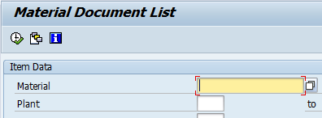
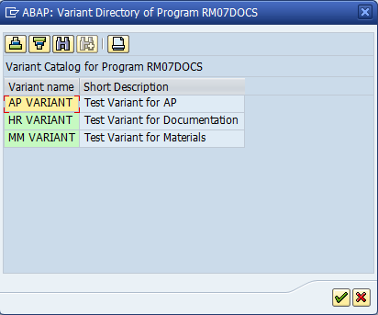
Use a Selection Variant
Complete the following steps to use a saved selection variant.
1
Click the Get Variant… button or press Shift+F5 to display the list of saved variants.
2
Double-click the desired variant name and return to the report screen.
(Optional) Add date ranges or any additional information if needed.
Execute the report as usual.

Slide 122
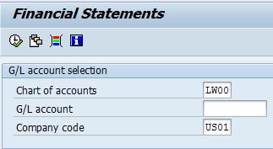
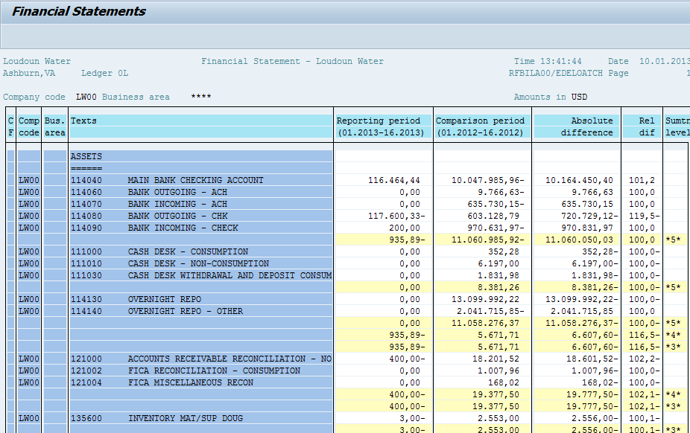
Execute a Report
Once you have entered values for the selection criteria (either manually or by using a variant), you are ready to execute the report.
1
2
1
Click to execute the report in the foreground.
The report data that meets the selection criteria will be displayed on the screen.
You may then customize the report display or download the data to Excel.
2

Slide 123
Demonstration
Activity Name: Execute a Report Using Multiple Selections and Variants
Transaction Name:
  TBD
  Transaction Code:
  TBD
  Path:
      TBD

Slide 124
Demonstration/Practice
  Scenario:
  You have created a Selection Variant called Framework for the ME2L Purchasing Documents per Vendor report for Vendors 1000000035 – 1000000099 for document type FO (Framework Order).
  Use the variant to execute the report
Exercise: 5.4 Execute a Report Using Multiple Selections and Variants
Notes:
Need to update.

Slide 125
Check Your Understanding
  Fill in the blank: A ______ is a group of selection criteria values that have been saved for future use.
  Adding a forward slash (/) in front of the variant name will allow others to use your variant. This is called a ______.
  How do you allow others to use your selection variant?
  Can you change the selection criteria in a selection variant?
Notes:
A group of selection criteria values that have been saved for future use.
Add a forward slash (/) in front of the variant name.
Yes.

Slide 126
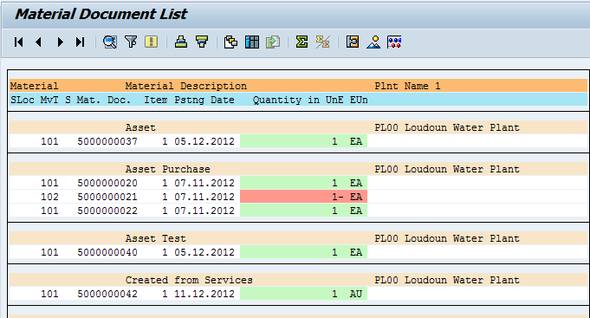
View Report Data
When you execute the report in the foreground, the report data that meets the selection criteria will be displayed on the screen.
Reporting Toolbar
Report Data
Notes:
To run a report in the “foreground” means to suspend your ability to use the system until the results are generate. You can also run a report in the background, which we will discuss later.

Slide 127
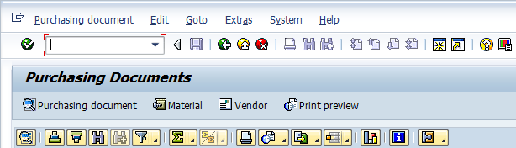
Reporting Toolbar
You can use the reporting toolbar to customize the report.
  The reporting toolbar displays the most common functions that appear on most reports as well as some report-specific buttons.
  However, not all buttons will appear on the reporting toolbar for all the reports. Many times if a button does not appear in the toolbar, the functionality will be available by selecting Extras.
  In addition, report-specific buttons will only appear on the reporting toolbar for some reports.
Notes:
You can customize the SAP ECC report to meet your business and reporting needs:
You can sort the report data (for example, you can sort the report data by the posting date of the invoice in ascending order)
You can filter the report data, i.e., you can restrict it to display data for specific values only (for example, view purchase order data for only one vendor)
You can total and sub-total values in a column
You can drill-down and drill-across into the report data to view additional lower-level details (for example, view the line items of a posted invoice)
You can also change the layout of the report by changing the position and width of columns and by adding or hiding columns

Slide 128
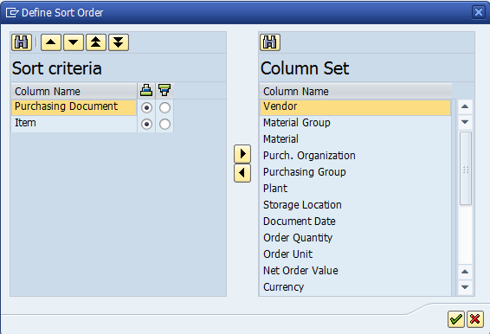
Sort Report Data
You can sort the report data in ascending or descending order by a selected column.
  For example, sort the data by clearing date, then document type in ascending order.
1
Click on the toolbar to Sort in ascending order.
2
The Define sort order dialog box provides you the ability to sort by multiple criteria. The values on the left indicate what fields are being sorted, and are sorted in the order listed. The values on the right are available to sort by, even if they do not currently display on the report.

Slide 129
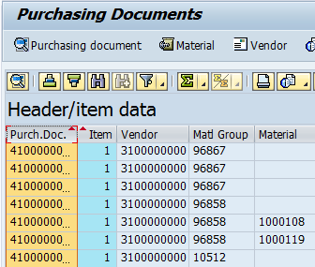
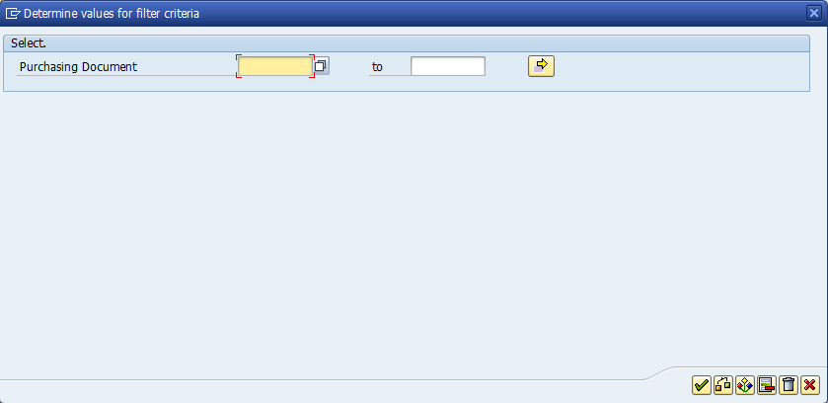
Filter Report Data
You can filter the report data to restrict the display to one or more values in a selected column.
  For example, you want to view data for only a few document numbers.
Click the column heading for which you wish to filter
Click the arrow on the Filter button and select Set Filter…
Enter the filter data in the dialog box
Click the green check mark to accept filter criteria.
2
1
3
4

Slide 130
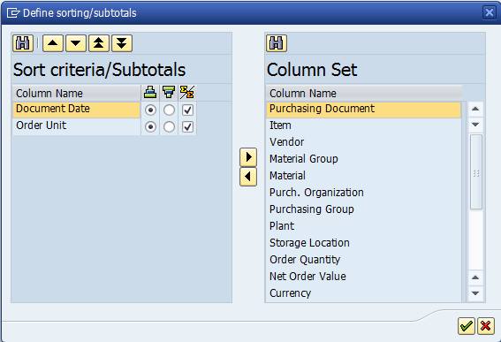
Total/Sub-total Report Data
You can sum up the total value of amounts in a selected column. Once totaled, you can sub-total the amounts by another column.
  For example, you can sub-total the invoice amounts for each vendor.
1
Click the arrow on the Subtotal icon and select Subtotals…
2
The Define sort order dialog box displays with the added checkbox option of sub-total/total. The sort fields previously selected are still valid, and you have the option of including additional values to sort on. Selecting the sub-total/total checkbox will calculate based on that selection.

Slide 131
Demonstration
Activity Name: Sort, Filter, and Subtotal Report Data
Transaction Name:
  TBD
  Transaction Code:
  TBD
  Path:
      TBD

Slide 132
Practice
  Scenario:
  You are currently in the FBL1N Vendor Line Item Display report.
  You wish to sort the invoices in ascending order by vendor.
  You then wish to filter the report data to display data for only vendor number XXXXX
  You finish by subtotaling invoice amounts by Vendor
Exercise: 5.5 Sort, Filter, and Subtotal Report Data
Notes:
Need to update.

Slide 133
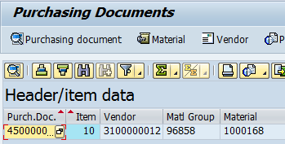
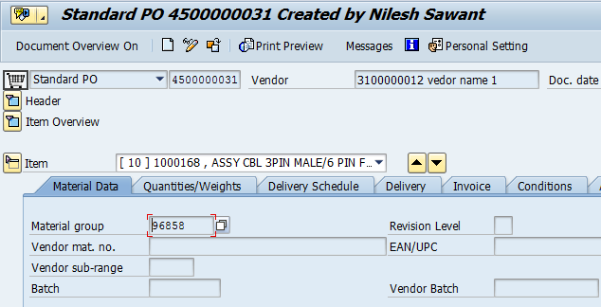
Drill-Down into Report Details
You can drill-down to lower levels of detail from the report data and view the source document.
1
Double-click a line item to display details.
2
Click to return to the report data.

Slide 134
Demonstration
Activity Name: Drill down into Report Data
Transaction Name:
  TBD
  Transaction Code:
  TBD
  Path:
      TBD
Notes:
Quick demo

Slide 135
Practice
  Scenario:
  You are currently in the FBL3N G/L Account Item Display report.
  You wish to drilldown into Document No. 100515076 to view historical data to review specific line items that have posted to that document
Exercise: 5.6 Drill-Down into Report Data

Slide 136
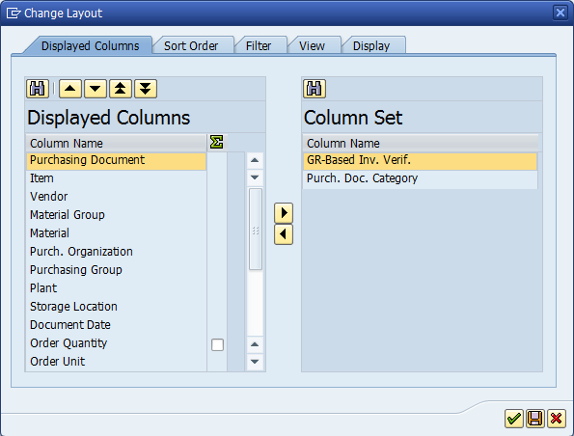
Change Report Display Layout
Complete the following steps to save a customized report layout as a display variant.
2
1
Change the position and length of the columns, as needed.
Click the arrow on the Choose Layout…button and select Change Layout…
3
Add and remove columns by using the arrows
4
Click to continue. The report layout will reflect the changes made here.
Notes:
Report data usually appears in the default layout most often used within Loudoun Water
However, you can change or customize the layout of the report by:
Changing the position of the columns
Changing the width of the columns
Hiding columns
Adding columns

Slide 137
Demonstration
Activity Name: Change Report Layout
Transaction Name:
  TBD
  Transaction Code:
  TBD
  Path:
      TBD

Slide 138
Practice
  Scenario:
  You are currently in the Payment and Receipt Tracking report.
  You wish add columns for Req. Tracking Number and Requisitioner.
  You wish to move the Vendor Number and Vendor Name columns to the second and third place respectively.
  You wish to sort the results in ascending order by Purchase Order and then descending by P.O. Date.
  You wish to subtotal report data by Purchase Order.
Exercise: 5.7 Change Report Layout
Notes:
Update

Slide 139
Check Your Understanding
What toolbar is used to customize the report?
Can you sort data by more than one value?
How do you drill down into a report?
Notes:
The Reporting toolbar.
Yes, the Define sort order dialog box provides you the ability to sort by multiple criteria.
Double click a line item to display lower level details.

Slide 140
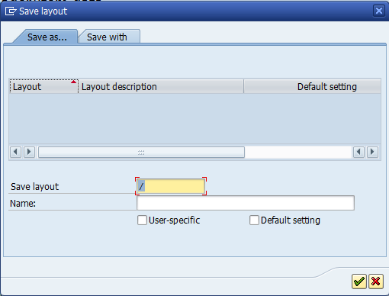
Save Display Variant
Once you have customized the report layout, you can save it as a display variant.
1
Click the arrow on the Choose Layout…button and select Change Layout…
2
Enter a Layout name and a Description of the display variant.
Enter a forward slash (/) in front of the name if you wish to make the variant available to others.
Check the User-specific box to lock the variant from being changed by anyone except yourself.
3
Click to continue. The layout will be saved as a display variant.
Notes:
Once you have customized the report layout to meet your needs, you can save the layout for future use.
A saved, customized report layout is called a Display Variant.
You can “recall” the display variant the next time you execute the report.
The report data will be automatically displayed according to the saved layout.
A report can have several different display variants, with each display variant using a different layout.
Adding a forward slash (/) in front of the variant name will make the variant available to others. This is called a Global Variant.

Slide 141
Demonstration
Activity Name: Create Display Variant
Transaction Name:
  TBD
  Transaction Code:
  TBD
  Path:
      TBD

Slide 142
Practice
  Scenario:
  You are currently in the XXX report.
  You have customized the report layout to sort by Requisitioner and subtotal by PO Number.
  Save the customized report layout as display variant PO Sort with the description PO Sort order by Requisitioner.
Exercise: 5.8 Create Display Variant

Slide 143

Use an Existing Display Variant
You can change the displayed report layout by selecting an existing display variant.
1
Click the arrow on the Choose Layout…button and select Choose Layout…
2
Select the display variant you want to use by single-clicking the line item.
Click to continue. The selected display variant will be applied to the report.
3

Slide 144
Demonstration
Activity Name: Execute a Report Using Multiple Selections, Dynamic Selections, and Variants
Transaction Name:
  TBD
  Transaction Code:
  TBD
  Path:
      TBD

Slide 145
Practice
  Scenario:
  You wish to execute the S_ALR_87012284 Balance Sheet P&L Statement report using selection variant /Trial Bal CG and display variant SH TB Layout.
  After executing the report, you wish to change the layout to display variant Deb’s. TB Rollup to FS Item.
  .
Exercise: 5.9 Execute Report Using Multiple Selections and Variants
Notes:
Need to update data.

Slide 146
Check Your Understanding
What is the difference between a Selection Variant and Display Variant?
Notes:
1. A selection variant is a group of selection criteria values that have been saved for future use. It produces the report. A Display Variant is the unique format you wish to view the report in.

Slide 147


Export Report Data
Once report or query data has been generated, it can be downloaded to an Excel spreadsheet for easier viewing.
1
Click the arrow on the Export button and select Spreadsheet to download the data displayed in the current report.
2
Select the desired format, then click to continue.
Notes:
SAP ECC allows you to export report data to commonly used PC applications, such as Microsoft Word and Excel.
Data from reports can be easily downloaded as spreadsheets or other file formats.
There are several reasons for downloading or exporting report data:
You have greater control and flexibility over the format or organization of report data.
You can share the report data with others who do not have access to SAP ECC.
However, there may be potential risks with downloaded data:
It may be more difficult to impose security controls.
The integrity of downloaded data may be jeopardized.
Downloaded data is a snapshot in time and quickly loses its “real-time” character.

Slide 148
Demonstration
Activity Name: Export Report Data to Excel
Transaction Name:
  TBD
  Transaction Code:
  TBD
  Path:
      TBD

Slide 149
Practice
  Scenario:
  You are currently in the Payment and Receipt Tracking report.
  You wish to export the report data into an Excel file named Report.xls.
  You will use the More > Local file option to download the report data.
Exercise: 5.10 Export Report Data to Excel

Slide 150




Print Report – Output Requests
You can print the report data immediately from SAP to your network printer.
1
Click the Print button .
2
The listed Output Device will display your defaulted printer if you have set one up. If not, use the match icon to select your printer
3
Click the button to select the print parameters.
4
Double-click the Time of Printing option, select the Print out immediately option.
Notes:
Unlike most other programs, which forward print requests directly to the printer, SAP temporarily stores the print data.
An output request sends the data to the desired output device (printer) and allows you to select a printer other than your default printer if needed.
If your list is large, SAP takes longer to process the data. If SAP cannot process the data, a message indicating processing limitations appears in the status bar. In that case, you must:
Enter additional selection criteria to refine the report data returned, or
Print the list using background processing

Slide 151



Set Your Default Printer in SAP
Because SAP runs on a different platform than Windows, you must specify which SAP-supported network printer to print to. SAP will not automatically send print requests to your Windows-defaulted printer.
1
In the Command Field, enter /nSU3 and press Enter to go to the Maintain User Profile transaction.
3
You may enter delimiting selection criteria in the search fields if desired.
Click Start Search to display a list of available network printers.
2
Select the Defaults tab, then in the Spool Control section, select the match code for OutputDevice
Click the desired selection, then click
Click on the Maintain User Profile screen to save your selection.
4
Notes:
Check with IT and make sure this is current.

Slide 152
Demonstration
Activity Name: Print Report from SAP
Transaction Name:
  N/A
  Transaction Code:
  N/A
  Path:
      N/A

Slide 153
Practice
  Scenario:
  You have generated a report in SAP and wish to send the report to an SAP printer to print immediately
  You discover that your default setting needs to be changed to accommodate this print request as a default for future use
  You will change the default setting for printing from SAP.
  .
Exercise: 5.11 Print From SAP

Slide 154



Execute Report in Background
SAP background processing is particularly relevant for long-running reports that do not require any interactive input.
1
Select Program > Execute in Background.
Click to change the Time of Printing to Send to SAP Spooler only for now.
The Start Time menu allows you to select a specific date and time to execute the report. You may also elect to have a series of reports run sequentially by selecting the After job option.
You may also use Periodic Values to run reports at a regular date and time, such as month-end reports.
1
2
3
2
3
Notes:
You can schedule reports to process in the background when there is a lot of data to evaluate; otherwise the system performance may be adversely affected.
Running a report in the background does not tie up the SAP sessions you are currently working with
When you start a report interactively, your current SAP session is blocked for further input for as long as the report runs
When you start the report in the background, running the report does not influence your interactive work with SAP
You can shift the execution of reports to the evening or other periods of low loads on SAP
You can schedule a report to run at any time, even automatically on a regular basis, for example on a daily, weekly or monthly basis
Background processing is the only way you can execute long-running jobs
To prevent tying up system resources with interactive sessions for long reports, SAP has a built-in time limit on interactive sessions. If a single report runs for more than 5 minutes continuously, SAP terminates the report automatically.

Slide 155
Demonstration
Activity Name: Schedule a Report to Execute in the Background
Transaction Name:
      N/A
  Transaction Code:
      N/A
  Path:
      N/A

Slide 156
Practice
  Scenario:
  As part of your tasks, you always execute a Balance Sheet P&L Statement for G/L Accounts 100000 to 100900 for Company Code 1000
  You wish to set this report up to run every Sunday night so it will be ready for you on Monday mornings to review
  You will schedule the report to execute in the background and use Periodic Values to schedule it to execute every week.
  .
Exercise: 5.12 Schedule Report to Execute in Background
Notes:
Update

Slide 157

View and Print Reports Run in Background
After processing reports in the background, you may view a log of all background jobs you have requested.
From the Job Overview transaction, you can edit or delete future jobs, review completed jobs, and print reports that have run.

Slide 158
Demonstration
Activity Name: View Log of Reports Executed in Background
Transaction Name:
  Simple Job Selection
  Transaction Code:
  SM37
  Path:
      N/A

Slide 159
Practice
  Scenario:
  You executed a report using background processing and wish to preview the report prior to sending it to the printer
  You will use transaction code SM37 to view a log of your reports processed in the background
  You will open a report to view the data, then send the report to the printer.
  .
Exercise: 4.15 View Log of Reports Executed in Background

Slide 160
Check Your Understanding
What is an output request?
Why would you opt to run a report in the background?
SAP has a time limit on interactive sessions. What is it?
Notes:
An action to send the report data to the desired output device.
Running a report in the background does not tie up the SAP session you are currently working with. In addition, you can shift the execution of the report to the evening or other periods of low loads on SAP.
If a single report runs for more than 5 minutes continuously, SAP terminates the report automatically.

Slide 161
Questions
What other questions do you have?

Slide 162
Module Summary
Having completed this module, you should be able to:
Describe ECC Reports
Describe types of reports available
Access reports using a menu path or transaction code
Enter selection criteria for a report
Create and use variants
Execute reports
Customize report data (filter, sort, subtotal, etc.)
Drill down to a source document from a report
Modify the layout of the report data
Print reports in both foreground and background

Slide 163
Summary
Module 6

Slide 164
Course Summary
Having completed this course, you should be able to:
Explain the Loudoun Water financial structure and how it is supported in SAP
Access SAP ECC through the GUI and navigate within SAP
Describe various types of reports available in SAP
Access reports using a menu path or transaction code
Use the features of SAP to generate reports and customize for personal use
Access Help functions for SAP

Slide 165

Course Evaluation
Please visit the Learning Portal and complete the Course Evaluation located in the Help tab. The evaluations are anonymous and your input will help improve future training.
Go to the Learning Portal and open the Help tab, or type in the following address to start the survey:
  (Insert Survey Monkey link here)

Slide 166

Congratulations!
you successfully
completed the
ECC Basic Navigation
Course

